Slide 1
Wireless Mobile Communication

Slide 2
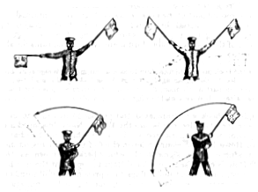
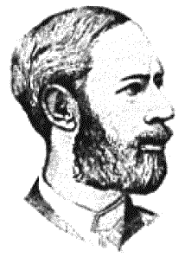
Early history of wireless communication
Many people in history used light for communication
  heliographs, flags („semaphore“), ...
  150 BC smoke signals for communication;
  (Polybius, Greece)
  1794, optical telegraph, Claude Chappe
Here electromagnetic waves are
of special importance:
  1831 Faraday demonstrates electromagnetic induction
  J. Maxwell (1831-79): theory of electromagnetic Fields, wave equations (1864)
  H. Hertz (1857-94): demonstrates
  with an experiment the wave character
  of electrical transmission through space
  (1886, in Karlsruhe, Germany, at the
  location of today’s University of Karlsruhe)

Slide 3
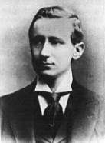
1895 Guglielmo Marconi
  first demonstration of wireless
  telegraphy (digital!)
  long wave transmission, high
  transmission power necessary (> 200kw)
1907 Commercial transatlantic connections
  huge base stations
  (30 100m high antennas)
1915 Wireless voice transmission New York - San Francisco
1920 Discovery of short waves by Marconi
  reflection at the ionosphere
  smaller sender and receiver, possible due to the invention of the vacuum tube (1906, Lee DeForest and Robert von Lieben)
1926 Train-phone on the line Hamburg - Berlin
  wires parallel to the railroad track

Slide 4
1928 many TV broadcast trials (across Atlantic, color TV, TV news)
1933 Frequency modulation (E. H. Armstrong)
1958 A-Netz in Germany
  analog, 160MHz, connection setup only from the mobile station, no handover, 80% coverage, 1971 11000 customers
1972 B-Netz in Germany
  analog, 160MHz, connection setup from the fixed network too (but location of the mobile station has to be known)
  available also in A, NL and LUX, 1979 13000 customer in D
1979 NMT at 450MHz (Scandinavian countries)
1982 Start of GSM-specification
  goal: pan-European digital mobile phone system with roaming
1983 Start of the American AMPS (Advanced Mobile Phone System, analog)
1984 CT-1 standard (Europe) for cordless telephones

Slide 5
1986 C-Netz in Germany
  analog voice transmission, 450MHz, hand-over possible, digital signaling, automatic location of mobile device
  still in use today (as T-C-Tel), services: FAX, modem, X.25, e-mail, 98% coverage
1991 Specification of DECT
  Digital European Cordless Telephone (today: Digital Enhanced Cordless Telecommunications)
  1880-1900MHz, ~100-500m range, 120 duplex channels, 1.2Mbit/s data transmission, voice encryption, authentication, up to several 10000 user/km², used in more than 40 countries
1992 Start of GSM
  in D as D1 and D2, fully digital, 900MHz, 124 channels
  automatic location, hand-over, cellular
  roaming in Europe - now worldwide in more than 100 countries
  services: data with 9.6kbit/s, FAX, voice, ...

Slide 6
1994 E-Netz in Germany
  GSM with 1800MHz, smaller cells, supported by 11 countries
  as Eplus in D (1997 98% coverage of the population)
1996 HiperLAN (High Performance Radio Local Area Network)
  ETSI, standardization of type 1: 5.15 - 5.30GHz, 23.5Mbit/s
  recommendations for type 2 and 3 (both 5GHz) and 4 (17GHz) as wireless ATM-networks (up to 155Mbit/s)
1997 Wireless LAN - IEEE802.11
  IEEE-Standard, 2.4 - 2.5GHz and infrared, 2Mbit/s
  already many products (with proprietary extensions)
1998 Specification of GSM successors
  for UMTS (Universal Mobile Telecommunication System) as European proposals for IMT-2000
Iridium
  66 satellites (+6 spare), 1.6GHz to the mobile phone

Slide 7
Generations of Cellular Mobile Radiophones*
1G
  Advanced Mobile Phone System (AMPS): 1980s, Frequency Modulation (FM), Frequency Division Multiple Access (FDMA), handover between cells, limited roaming between networks
2G
  Global System for Mobile communications (GSM): 1990s, digital-coding of voice, Time Division Multiple Access (TDMA), Subscriber Identity Module (SIM), data communications
3G
  3G Partnership Project (3GPP), Universal Mobile Telecommunications System (UMTS): 1998-, Wideband Code Division Multiple Access (WCDMA), use of GSM network model, global roaming; 2 Mbps data
4G
  All-IP-based, 100 Mbps data

Slide 8
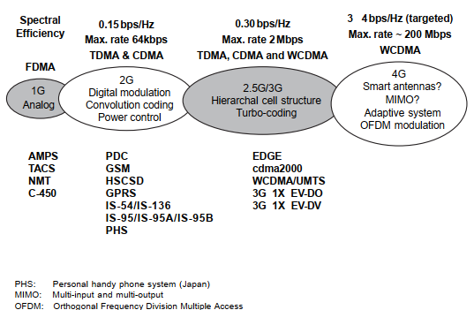

Slide 9
Wireless Comes of Age
Guglielmo Marconi invented the wireless telegraph in 1896
  Communication by encoding alphanumeric characters in analog signal
  Sent telegraphic signals across the Atlantic Ocean in 1901
Communications satellites launched in 1960s
Advances in wireless technology
  Radio, television, communication satellites, wireless networking, cellular technology

Slide 10
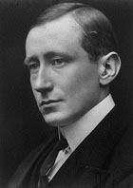
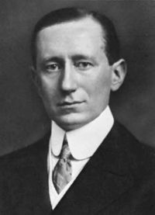
Guglielmo Marconi
(Rome, Italy) (1874~1937)

Slide 11
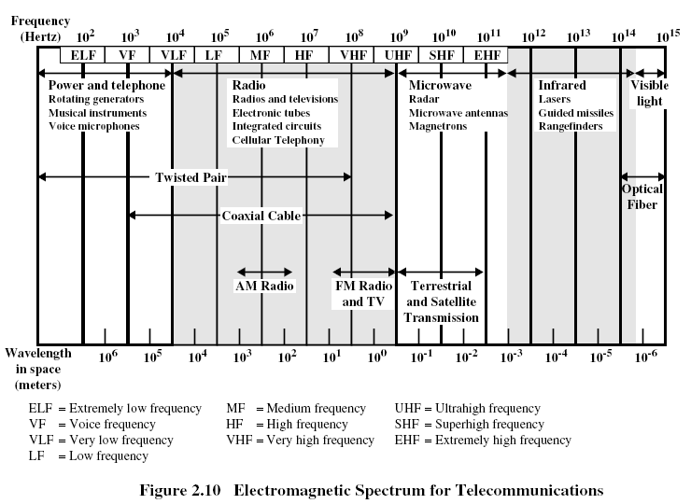

Slide 12
Wireless channels are limited
Item | Europe (MHz) | US (MHz) | Japan (MHz)
Mobile Phones | NMT: 453-457, 463-467 GSM: 890-915, 935-960, 1710-1785, 1805-1880 | AMPS, TDMA, CDMA 824-849, 869-894 GSM, TDMA, CDMA 1850-1910, 1930-1990 | PDC: 810-826 940-956, 1429-1465, 1477-1513.
Cordless Phones | CT1+: 885-887, 930-932 CT2: 864-868 DECT: 1880-1900 | PACS 1850-1910,1930-1990; PACS-UB: 1910-1930 | PHS 1895-1918; JCT: 254-380
NMT: Nordic Mobile Telephone
PDC: Pacific Digital Cellular
PACS: Personal Access Communications System
PHS: Personal Handyphone System
PACS-UB: PACS Unlicensed Band
JCT: Japanese Cordless Telephone
(Taken from Mobile Communications by Jochen Schiller)

Slide 13
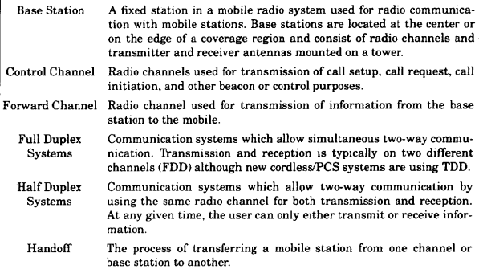

Slide 14
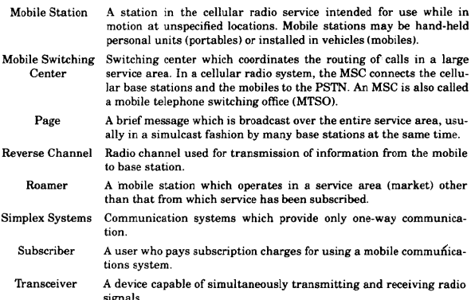

Slide 15
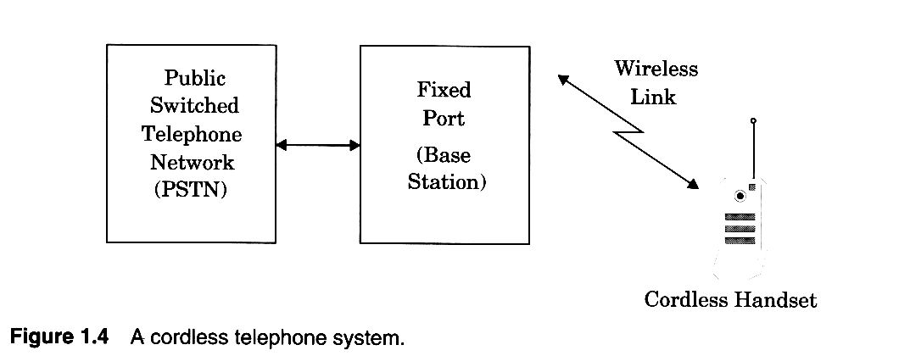
Cordless handsets
Notes:
First generation Cordless phones were sued inside the house. Connects to Wired telephone system and range is few tens of a meter.
Limited range and mobility

Slide 16
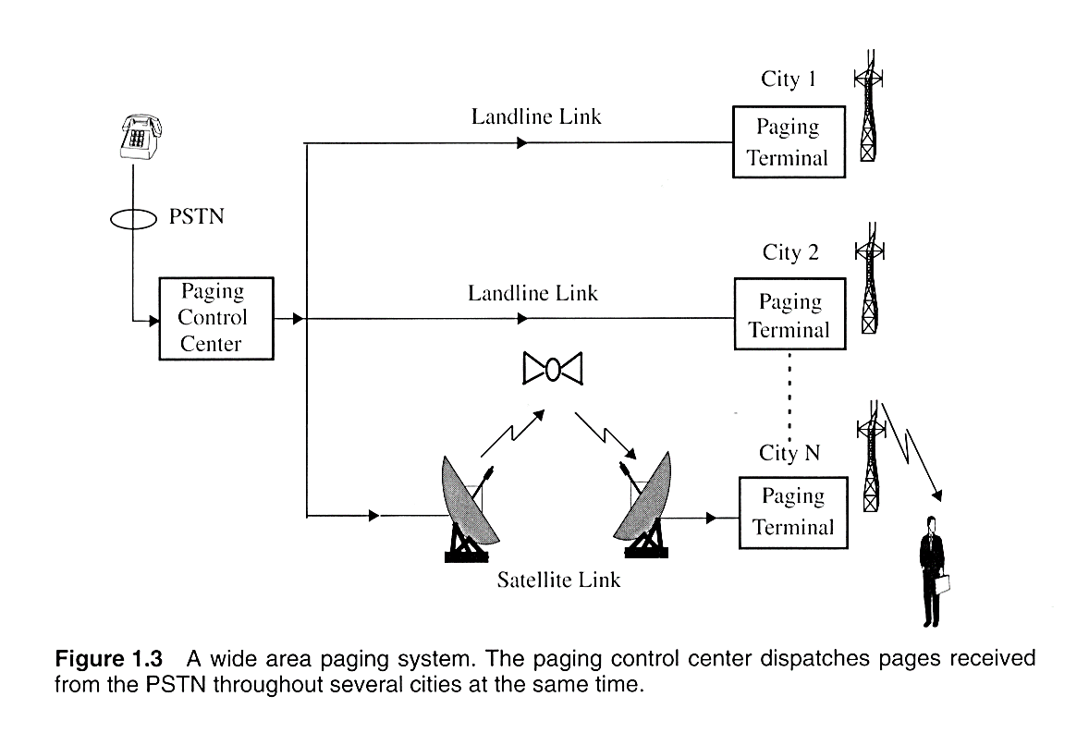
Wide area Paging system
Notes:
Paging is usually one way. It can be Numeric, alphanumeric or a voice message. They are used to notify a subscriber that they need to call back or get in touch with somebody. Some applicatios are:
New headlines
Stock quoattions
Fax
Network management
Distance and coverage:
Inside a building
Simple : 2 to 5 Kms
Wide area paging : worldwide coverage.
Concept is simple but the transmission systems are quite complicated

Slide 17
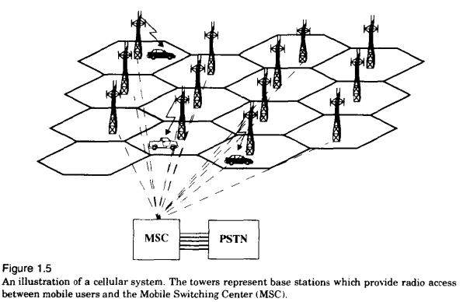

Slide 18


Fundamentals of Cellular Systems
Ideal cell area
(2-10 km radius)
Cell
BS
MS
Alternative shape of a cell
MS
Hexagonal cell area used in most models
Illustration of a cell with a mobile station and a base station

Slide 19
Cellular Wireless Networks
key technology for mobiles, wireless nets etc
developed to increase mobile phone capacity
based on multiple low power transmitters
area divided into cells
  in a tiling pattern to provide full coverage
  each with own antenna
  each with own range of frequencies
  served by base station
  adjacent cells use different frequencies to avoid crosstalk
Notes:
Of all the tremendous advances in data communications and telecommunications, perhaps the most revolutionary is the development of cellular networks. Cellular technology is the underlying technology for mobile telephones, personal communications systems, wireless Internet and wireless Web applications, and much more. It is a technique developed to increase the capacity available for mobile radio telephone service. Contrast with the older mobiles using large area, high-power transmitters. The essence of a cellular network is the use of multiple low-power transmitters. The area to be covered is divided into cells in a hexagonal tile pattern that provide full coverage of the area. Because the range of such a transmitter is small, an area can be divided into cells, each one served by its own antenna. Each cell is allocated a band of frequencies and is served by a base station, consisting of transmitter, receiver, and control unit. Adjacent cells are assigned different frequencies to avoid interference or crosstalk. However, cells sufficiently distant from each other can use the same frequency band.

Slide 20
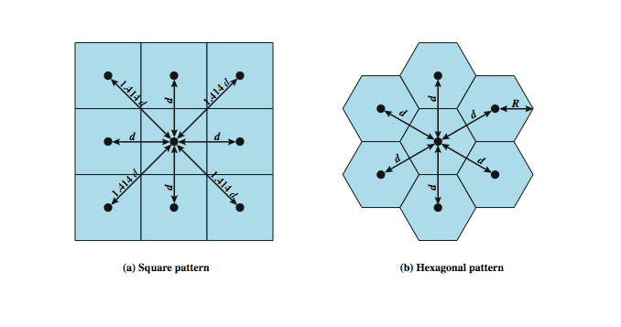
Cellular Geometries
Notes:
The first design decision to make is the shape of cells to cover an area. A matrix of square cells would be the simplest layout to define, as seen here in Stallings DCC8e Figure 14.1a. However, this geometry is not ideal. If the width of a square cell is d, then a cell has four neighbors at a distance d and four neighbors at a distance d. As a mobile user within a cell moves toward the cell's boundaries, it is best if all of the adjacent antennas are equidistant. This simplifies the task of determining when to switch the user to an adjacent antenna and which antenna to choose.
A hexagonal pattern provides for equidistant antennas (Figure 14.1b). The radius of a hexagon is defined to be the radius of the circle that circumscribes it (equivalently, the distance from the center to each vertex; also equal to the length of a side of a hexagon). For a cell radius R, the distance between the cell center and each adjacent cell center is d = R. In practice, a precise hexagonal pattern is not used. Variations from the ideal are due to topographical limitations, local signal propagation conditions, and practical limitation on siting antennas.

Slide 21
Cell Shape
R
R
R
Cell
R
R
(a) Ideal cell
(b) Actual cell
(c) Different cell models

Slide 22
Signal Strength
Signal strength (in dB)
Cell i
Cell j
-60
-60
-70
-70
-80
-80
-90
-90
-100
-100
Select cell i on left of boundary
Select cell j on right of boundary
Ideal boundary

Slide 23
Signal Strength
Signal strength (in dB)
Cell i
Cell j
-60
-70
-60
-80
-70
-90
-80
-90
-100
-100
Signal strength contours indicating actual cell tiling. This happens because of terrain, presence of obstacles and signal attenuation in the atmosphere.

Slide 24
Tessellation
Some group of small regions tessellate a large region if they over the large region without any gaps or overlaps.
There are only three regular polygons that tessellate any given region.

Slide 25
Tessellation (Cont’d)
Three regular polygons that always tessellate:
  Equilateral triangle
  Square
  Regular Hexagon
Triangles
Squares
Hexagons

Slide 26
Radio Planning
  Design process of selecting and allocating channel frequencies for all cellular base stations within a system is known as frequency re-use or frequency planning.
  Cell planning is carried out to find a geometric shape to
    tessellate a 2D space
    represent contours of equal transmit power
  Real cells are never regular in shape

Slide 27
Two-Dimensional Cell Clusters
Regular geometric shapes tessellating a 2D space: Square, triangle, and hexagon.
‘Tessellating Hexagon’ is often used to model cells in wireless systems:
  Good approximation to a circle (useful when antennas radiate uniformly in the x-y directions).
  Also offer a wide variety of reuse pattern
  Simple geometric properties help gain basic understanding and develop useful models.

Slide 28
Frequency Reuse
must manage reuse of frequencies
power of base transceiver controlled
  allow communications within cell on given frequency
  limit escaping power to adjacent cells
  allow re-use of frequencies in nearby cells
  typically 10 – 50 frequencies per cell
  example for Advanced Mobile Phone Service (AMPS)
    N cells all using same number of frequencies
    K total number of frequencies used in systems
    each cell has K/N frequencies
    K=395, N=7 giving 57 frequencies per cell on average
Notes:
With a wireless cellular system, you are limited in how often you can use the same frequency for different communications because the signals, not being constrained, can interfere with one another even if geographically separated. Systems supporting a large number of communications simultaneously need mechanisms to conserve spectrum. In a cellular system, each cell has a base transceiver. The transmission power is carefully controlled (to the extent that it is possible in the highly variable mobile communication environment) to allow communication within the cell using a given frequency while limiting the power at that frequency that escapes the cell into adjacent ones. The objective is to use the same frequency in other nearby cells, thus allowing the frequency to be used for multiple simultaneous conversations. Generally, 10 to 50 frequencies are assigned to each cell, depending on the traffic expected.
The essential issue is to determine how many cells must intervene between two cells using the same frequency so that the two cells do not interfere with each other. Various patterns of frequency reuse are possible. If the pattern consists of N cells and each cell is assigned the same number of frequencies, each cell can have K/N frequencies, where K is the total number of frequencies allotted to the system. For AMPS (Section 14.2), K = 395, and N = 7 is the smallest pattern that can provide sufficient isolation between two uses of the same frequency. This implies that there can be at most 57 frequencies per cell on average.

Slide 29
Frequency Reuse in AMPS
In frequency reuse, a group of local cells use different frequencies to transmit/receive signals in their cell.
This group of local cells is referred to as a cluster.

Slide 30
Frequency Reuse
Extensive frequency reuse allows for many users to be supported at the same time.
Total spectrum allocated to the service provider is broken up into smaller bands.
A cell is assigned one of these bands. This means all communications (transmissions to and from users) in this cell occur over these frequencies only.

Slide 31
Frequency Reuse (Cont’d)
Neighboring cells are assigned a different frequency band.
This ensures that nearby transmissions do not interfere with each other.
The same frequency band is reused in another cell that is far away. This large distance limits the interference caused by this co-frequency cell.
More on frequency reuse a bit later.

Slide 32
Frequency Reuse
Cellular relies on the intelligent allocation and re–use of radio channels throughout a coverage area.
Each base station is allocated a group of radio channels to be used within the small geographic area of its cell
Neighbouring base stations are given different channel allocation from each other

Slide 33
Frequency Reuse (Cont’d)
If we limit the coverage area within the cell by design of the antennas
  we can re-use that same group of frequencies to cover another cell separated by a large enough distance
  transmission power controlled to limit power at that frequency to keep interference levels within tolerable limits
  the issue is to determine how many cells must intervene between two cells using the same frequency

Slide 34
Example of Frequency Reuse
Cells using the same frequencies

Slide 35
Cell structure
Implements space division multiplex: base station covers a certain transmission area (cell)
Mobile stations communicate only via the base station
Advantages of cell structures:
  higher capacity, higher number of users
  less transmission power needed
  more robust, decentralized
  base station deals with interference, transmission area etc. locally
Problems:
  fixed network needed for the base stations
  handover (changing from one cell to another) necessary
  interference with other cells
Cell sizes from some 100 m in cities to, e.g., 35 km on the country side (GSM) - even less for higher frequencies

Slide 36
Frequency planning I
f₃
f₅
f₂
f₄
f₆
f₅
f₁
f₄
f₃
f₇
f₁
f₂
Frequency reuse only with a certain distance between the base stations
Standard model using 7 frequencies:
Fixed frequency assignment:
  certain frequencies are assigned to a certain cell
  problem: different traffic load in different cells
Dynamic frequency assignment:
  base station chooses frequencies depending on the frequencies already used in neighbor cells
  more capacity in cells with more traffic
  assignment can also be based on interference measurements

Slide 37
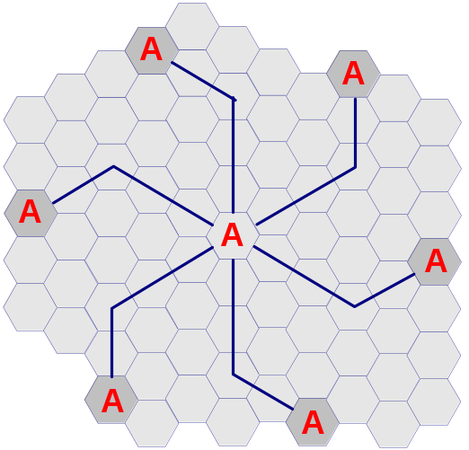
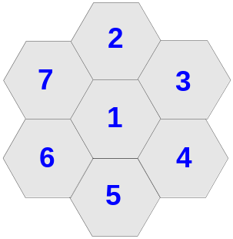
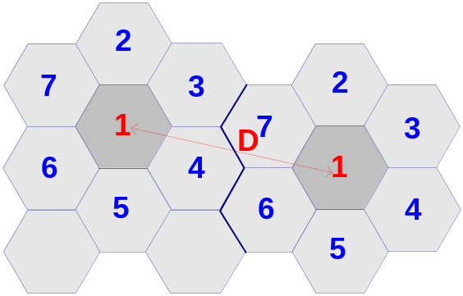
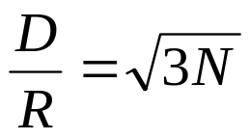
Frequency reuse
D = distance between cells using the same frequency
R = cell radius
N = reuse pattern (the cluster size, which is 7).
Thus, for a 7-cell group with cell radius R = 3 miles, the frequency reuse distance D is 13.74 miles.

Slide 38
Clustersize of 7
Assume a clustersize of 7. This means that the total 395 voice channels are divided into groups of seven.
Thus, each cell has about 56 voice channels. This is the most number of users that can be supported in a cell, i.e., roughly 10 square miles in normal environments.
This may/may not be sufficient based on the distribution of users.

Slide 39
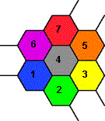
Clustersize of 7 (Cont’d)
To see what a system with clustersize of 7 looks like, color a cell with color 1.
This cell (if drawn as a hexagon) has 6 neighbors. Color each of the seven neighbors using a different color (also different from each other).
Now repeat this rule to get the overall “reuse pattern.”

Slide 40
Clustersize of 7, Reuse Pattern

Slide 41
What if we had a smaller cluster?
Now consider a system with a cluster of 4.
Then the number of voice channels per cell is 395/4, which is roughly 98.
Thus, in theory, we can hold more users per cell if this were true.
But there is a problem with a clustersize.

Slide 42
Problem with Smaller Clustersize
Interfering cells are closer by when clustersize is smaller.

Slide 43
Problem with Smaller Clustersize (Cont’d)
If interfering cells are closer, then the total interference power will be larger.
With higher interference power, the quality of the speech signal will deteriorate.
To reduce the interference power, we can make the cells larger.
With larger cell, the number of users covered per unit area reduces. So, the gain (total number of users supported) of a smaller clustersize is not as high as we think.

Slide 44
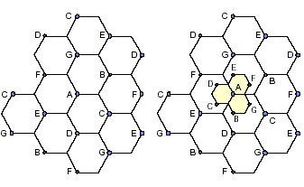
Illustration of cell splitting 1

Slide 45
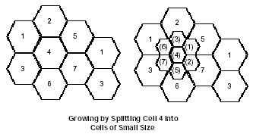
Illustration of cell splitting 2

Slide 46
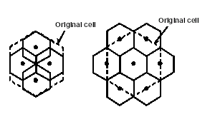
Illustration of cell splitting 3

Slide 47
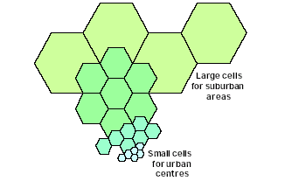
Cell Splitting

Slide 48
Design Tradeoff
Smaller cell means higher capacity (frequency reused more)
However, smaller cell also results in higher handoff probability, which also means higher overhead
Moreover, cell splitting should not introduce too much interference to users in other cells

Slide 49
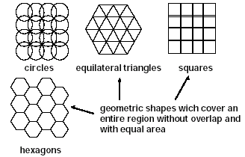
Coverage Patterns

Slide 50
Circular Coverage Areas
Original cellular system was developed assuming base station antennas are omnidirectional, i.e., they transmit in all directions equally.
Users located outside
some distance to the
base station receive
weak signals.
Result: base station has
circular coverage
area.
Weak signal
Strong signal

Slide 51
Circles Don’t Tessellate
Thus, ideally base stations have identical, circular coverage areas.
Problem: Circles do not tessellate.
The most circular of the regular polygons that tessellate is the hexagon.
Thus, early researchers started using hexagons to represent the coverage area of a base station, i.e., a cell.

Slide 52
Thus the Name Cellular
With hexagonal coverage area, a cellular network is drawn as:
Since the network resembles cells from a honeycomb, the name cellular was used to describe the resulting mobile telephone network.
Base
Station

Slide 53
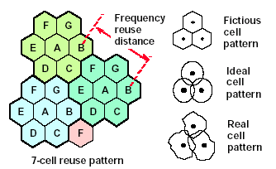
Cellular Coverage Representation

Slide 54
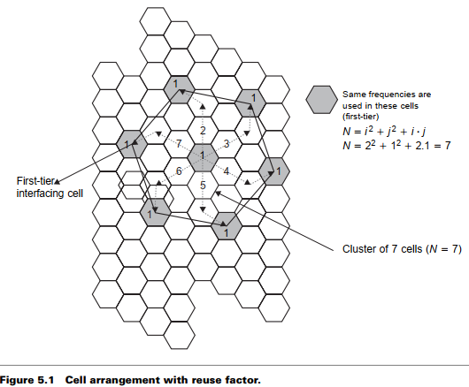

Slide 55
Personal Communication System (PCS)
Frequency reuse
D = distance between cells using the same frequency
R = cell radius
N = reuse pattern (the cluster size, which is 7).
Thus, for a 7-cell group with cell radius R = 3 miles, the frequency reuse distance D is 13.74 miles.

Slide 56
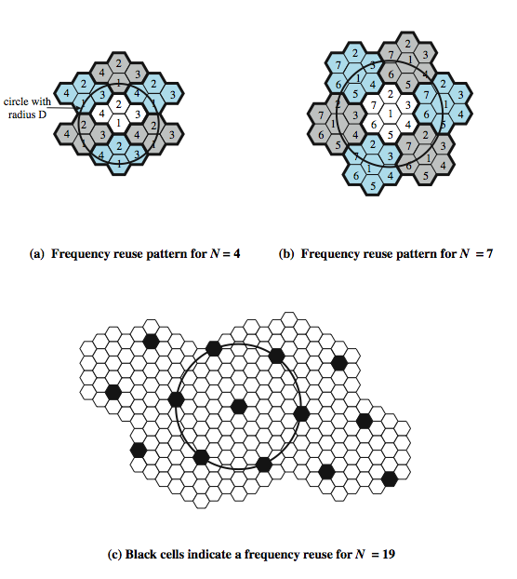
Frequency
Reuse
Patterns
Notes:
Stallings DCC8e Figure 14.2 shows some example reuse patterns. In characterizing frequency reuse, the following parameters are commonly used:
D = minimum distance between centers of cells that use the same band of frequencies (called cochannels)
R = radius of a cell
d = distance between centers of adjacent cells (d = R)
N = number of cells in repetitious pattern (reuse factor), each cell in pattern uses a unique band of frequencies.
With a hexagonal cell pattern, the following values of N possible
N = I² + J² + (I x J), I, J = 0, 1, 2, 3, …
Possible values of N are 1, 3, 4, 7, 9, 12, 13, 16, 19, 21, etc

Slide 57
Cell Structure
F7
F2
F1
F2
F1
F2
F6
F1
F3
F1
F2
F3
F3
F3
F4
F5
F4
(a) Line Structure
(b) Plan Structure
Note: Fx is set of frequency, i.e., frequency group.

Slide 58
Frequency Reuse
F7
F2
F7
F2
F6
F1
F3
F1
F6
F1
F3
F1
F5
F4
F7
F2
F5
F4
F7
F2
F6
F1
F3
F1
F6
F1
F3
F1
F5
F4
Reuse distance D
F5
F4
Fx: Set of frequency
7 cell reuse cluster

Slide 59

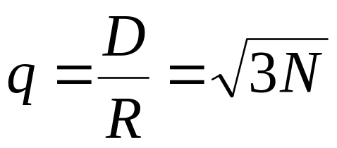
Reuse Distance
R
Cluster
For hexagonal cells, the reuse distance is given by
F7
F2
F6
F1
F3
F1
where R is cell radius and N is the reuse pattern (the cluster size or the number of cells per cluster).
F5
F4
F7
F2
F3
Reuse factor is
F6
F1
F1
Reuse distance D
F5
F4

Slide 60
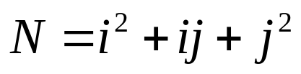
Reuse Distance (Cont’d)
The cluster size or the number of cells per cluster is given by
j
where i and j are integers.
60º
i
N = 1, 3, 4, 7, 9, 12, 13, 16, 19, 21, 28, …, etc.
The popular value of N being 4 and 7.

Slide 61
Reuse Distance (Cont’d)
j=1
j=1
i=2
j direction
i=2
j=1
i=2
60°
i=2
i direction
j=1
1 2 3 … i
j=1
i=2
i=2
j=1
(a) Finding the center of an adjacent cluster using integers i and j (direction of i and j can be interchanged).
(b) Formation of a cluster for N = 7 with i=2 and j=1

Slide 62
Reuse Distance (Cont’d)
j=2
i=3
j=2
i=3
j=2
i=2
j=2
j=2
j=2
i=2
i=2
i=3
i=3
i=2
i=2
j=2
j=2
j=2
i=2
j=2
i=3
j=2
i=3
j=2
(c) A cluster with N =12 with i=2 and j=2
(d) A Cluster with N = 19 cells with i=3 and j=2

Slide 63
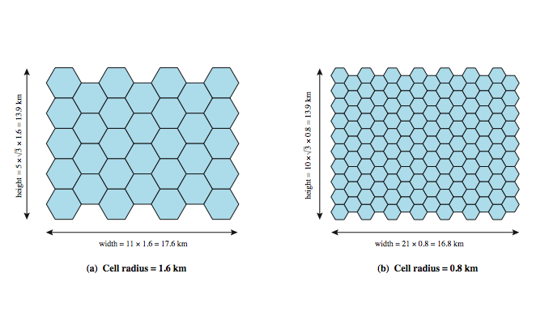
Frequency Reuse Example
Notes:
Stallings DCC8e Example. Assume a system of 32 cells with a cell radius of 1.6 km, a total of 32 cells, a total frequency bandwidth that supports 336 traffic channels, and a reuse factor of N = 7. If there are 32 total cells, what geographic area is covered, how many channels are there per cell, and what is the total number of concurrent calls that can be handled? Repeat for a cell radius of 0.8 km and 128 cells.
Stallings DCC8e Figure 14.4a shows an approximately square pattern. The area of a hexagon of radius R is . A hexagon of radius 1.6 km has an area of 6.65 km², and the total area covered is 6.65 × 32 = 213 km². For N = 7, the number of channels per cell is 336/7 = 48, for a total channel capacity of 48 × 32 = 1536 channels. For the layout of Figure 14.4b, the area covered is 1.66 × 128 = 213 km². The number of channels per cell is 336/7 = 48, for a total channel capacity of 48 × 128 = 6144 channels.

Slide 64
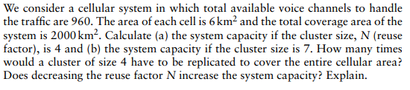
Question1

Slide 65
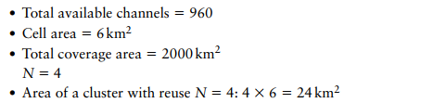
Question1

Slide 66
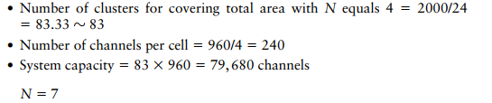
Question1

Slide 67
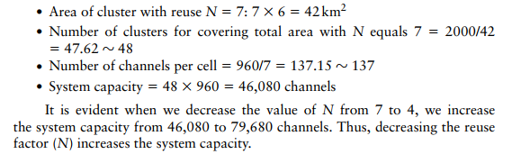

Slide 68

History: Cellular System
PSTN
MSC
MSC
MSC
BS
BS
BS
BS
BS
BS
BS
BS
BS
BS
BS
BS
BS
BS
BS
BS
BS
BS
BS
BS
BS
BS
BS
BS
BS
BS
BS
BS
BS
BS
BS
BS
BS
BS
BS
BS
BS
Notes:
BS- Base Station: Connection between the mobile user and public phone system
MSC - Mobile Switching Center: controls several BSs
PSTN - Public Switched Telephone Network: treat MSCs as ordinary fixed phone exchanges.

Slide 69
Cochannel Interference
First tier cochannel Base Station
Second tier cochannel Base Station
R
D₆
D₅
D₁
D₄
Mobile Station
D₂
D₃
Serving Base Station

Slide 70
Worst Case of Cochannel Interference
D₆
R
D₅
D₁
Mobile Station
D₄
D₂
D₃
Serving Base Station
Co-channel Base Station

Slide 71
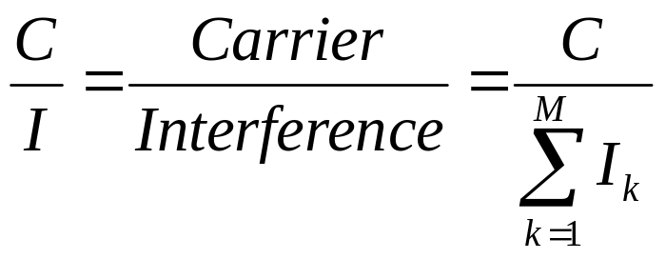
Cochannel Interference
Cochannel interference ratio is given by
where I is co-channel interference and M is the maximum number of co-channel interfering cells.
For M = 6, C/I is given by
C
C
where γ is the propagation path loss slope and γ = 2~5.
=
I
⎛
−γ
M
D
⎞
∑
⎜
k
⎟
⎝
R
⎠
k
=
1

Slide 72
Increasing Capacity
add new channels
  not all channels used to start with
frequency borrowing
  taken from adjacent cells by congested cells
  or assign frequencies dynamically
cell splitting
  non-uniform topography and traffic distribution
  use smaller cells in high use areas
Notes:
In time, as more customers use the system, traffic may build up so that there are not enough frequencies assigned to a cell to handle its calls. A number of approaches have been used to cope with this situation, including the following:
• Adding new channels: Typically, when a system is set up in a region, not all of the channels are used, and growth and expansion can be managed in an orderly fashion by adding new channels.
• Frequency borrowing: In the simplest case, frequencies are taken from adjacent cells by congested cells. The frequencies can also be assigned to cells dynamically.
Cell splitting: In practice, the distribution of traffic and topographic features is not uniform, and this presents opportunities for capacity increase. Cells in areas of high usage can be split into smaller cells.

Slide 73
Cell splitting calculations
Cell splitting subdivides a
congested cell into smaller cells,
each with its own base station.
Original large cell with radius R is split into medium cells with radius R/2.
Medium cell is further split into small cells with radius R/4.

Slide 74

Cell splitting from radius R to R/2 and R/4
R
R/2
Large cells
R/4
Medium cells
Small cells

Slide 75
System capacity increase using cell splitting
Example
  Consider a R - R/2 cell splitting
  system with R = 1 km.

Slide 76
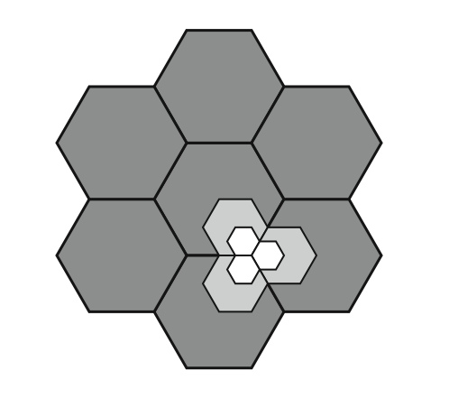
Cell Splitting
Notes:
Cells in areas of high usage can be split into smaller cells. Generally, the original cells are about 6.5 to 13 km in size. The smaller cells can themselves be split; however, 1.5-km cells are close to the practical minimum size as a general solution (but see the subsequent discussion of microcells). To use a smaller cell, the power level used must be reduced to keep the signal within the cell. Also, as the mobile units move, they pass from cell to cell, which requires transferring of the call from one base transceiver to another. This process is called a handoff. As the cells get smaller, these handoffs become much more frequent. Stallings DCC8e Figure 14.3 indicates schematically how cells can be divided to provide more capacity. A radius reduction by a factor of F reduces the coverage area and increases the required number of base stations by a factor of F².

Slide 77
Cell Splitting
Large cell (low density)
Small cell (high density)
Smaller cell (higher density)
Depending on traffic patterns the smaller cells may be activated/deactivated in order to efficiently use cell resources.

Slide 78
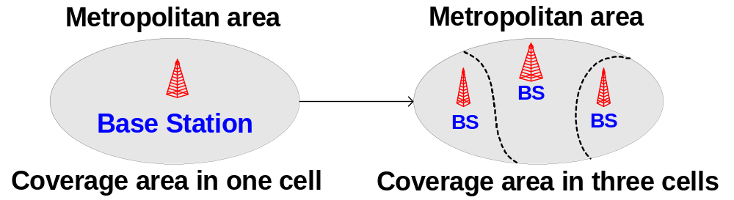
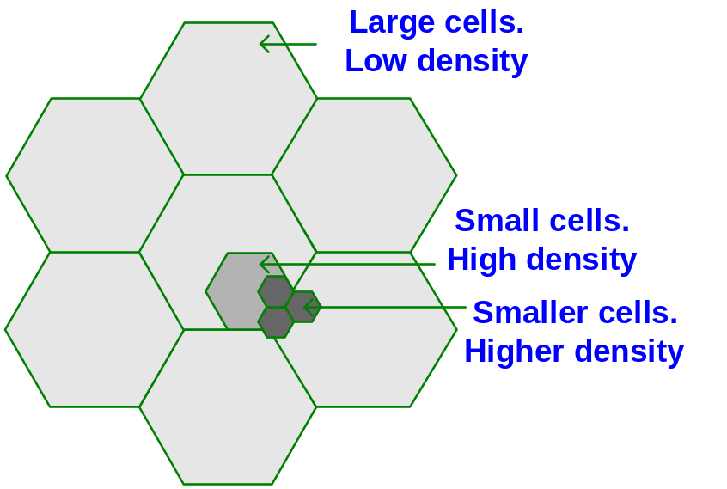
Personal Communication System (PCS)
Mobile cells

Slide 79
Cell Sectoring by Antenna Design
c
c
120º
120º
a
b
a
b
(a). Omni
(b). 120º sector
(c). 120º sector (alternate)
d
f
90º
e
60º
a
a
c
d
b
b
c
(d). 90º sector
(e). 60º sector

Slide 80
Cell Sectoring by Antenna Design
Placing directional transmitters at corners where three
adjacent cells meet
B
C
X
A

Slide 81
Increasing Capacity
cell sectoring
  cell divided into wedge shaped sectors (3–6 per cell)
  each with own channel set
  directional antennas
microcells
  move antennas from tops of hills and large buildings to tops of small buildings and sides of large buildings
  use reduced power to cover a much smaller area
  good for city streets, roads, inside large buildings
Notes:
Additional approaches to increase capacity include:
• Cell sectoring: With cell sectoring, a cell is divided into a number of wedge-shaped sectors, each with its own set of channels, typically three or six sectors per cell. Each sector is assigned a separate subset of the cell's channels, and directional antennas at the base station are used to focus on each sector.
• Microcells: As cells become smaller, antennas move from the tops of tall buildings or hills, to the tops of small buildings or the sides of large buildings, and finally to lamp posts, where they form microcells. Each decrease in cell size is accompanied by a reduction in the radiated power levels from the base stations and the mobile units. Microcells are useful in city streets in congested areas, along highways, and inside large public buildings.
The use of smaller cells enables the use of lower power and provides superior propagation conditions.

Slide 82
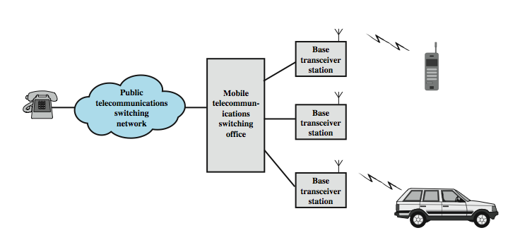
Overview of Cellular System
Notes:
Stallings DCC8e Figure 14.5 shows the principal elements of a cellular system. In the approximate center of each cell is a base station (BS). The BS includes an antenna, a controller, and a number of transceivers, for communicating on the channels assigned to that cell. The controller is used to handle the call process between the mobile unit and the rest of the network. At any time, a number of mobile user units may be active and moving about within a cell, communicating with the BS. Each BS is connected to a mobile telecommunications switching office (MTSO), with one MTSO serving multiple BSs. Typically, the link between an MTSO and a BS is by a wire line, although a wireless link is also possible. The MTSO connects calls between mobile units. The MTSO is also connected to the public telephone or telecommunications network and can make a connection between a fixed subscriber to the public network and a mobile subscriber to the cellular network. The MTSO assigns the voice channel to each call, performs handoffs, and monitors the call for billing information.

Slide 83
Cellular System Channels
system is fully automated
see two types of channels between mobile and base station (BS)
control channels
  set up and maintain calls
  establish relationship between mobile unit and nearest BS
traffic channels
  carry voice and data
Notes:
The use of a cellular system is fully automated and requires no action on the part of the user other than placing or answering a call. Two types of channels are available between the mobile unit and the base station (BS): control channels and traffic channels. Control channels are used to exchange information having to do with setting up and maintaining calls and with establishing a relationship between a mobile unit and the nearest BS. Traffic channels carry a voice or data connection between users.

Slide 84
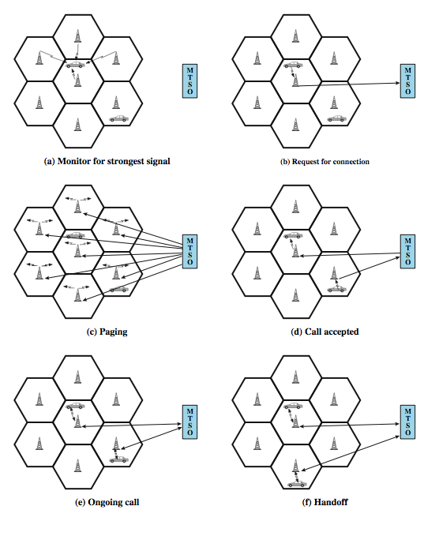
Call Stages
Notes:
Stallings DCC8e Figure 14.6 illustrates the steps in a typical call between two mobile users within an area controlled by a single MTSO:
• Mobile unit initialization: mobile unit scans and selects the strongest setup control channel used for this system (Figure 14.6a). Then a handshake takes place between the mobile unit and the MTSO controlling this cell, through the BS in this cell, to identify the user and register its location.
• Mobile-originated call: A mobile unit originates a call by sending the number of the called unit on the preselected setup channel (Figure 14.6b).
• Paging: The MTSO then attempts to complete the connection to the called unit, sending a paging message to certain BSs depending on the called mobile number (Figure 14.6c).
• Call accepted: The called mobile unit recognizes its number on the setup channel being monitored and responds to that BS, which sends the response to the MTSO. The MTSO sets up a circuit between the calling and called BSs, and also selects an available traffic channel within each BS's cell and notifies each BS, which in turn notifies its mobile unit (Figure 14.6d).
• Ongoing call: While connection is maintained, the mobile units exchange voice or data signals, through respective BSs and MTSO (Figure 14.6e).
• Handoff: If a mobile unit moves out of range of one cell and into the range of another during a connection, the traffic channel has to change to one assigned to the BS in the new cell (Figure 14.6f).

Slide 85
Other Functions
call blocking
  if all traffic channels busy
call termination
  when user hangs up
call drop
  when BS cannot maintain required signal strength
calls to/from fixed and remote mobile subscriber
  MTSO connects mobile user and fixed line via PSTN
  MTSO connects to remote MTSO via PSTN or dedicated lines
Notes:
Other functions performed by the system but not illustrated in Figure 14.6 include:
• Call blocking: During the mobile-initiated call stage, if all the traffic channels assigned to the nearest BS are busy, then the mobile unit makes a preconfigured number of repeated attempts. After a certain number of failed tries, a busy tone is returned to the user.
• Call termination: When one of the two users hangs up, the MTSO is informed and the traffic channels at the two BSs are released.
• Call drop: During a connection, because of interference or weak signal spots in certain areas, if the BS cannot maintain the minimum required signal strength for a certain period of time, the traffic channel to the user is dropped and the MTSO is informed.
• Calls to/from fixed and remote mobile subscriber: The MTSO connects to the public switched telephone network. Thus, the MTSO can set up a connection between a mobile user in its area and a fixed subscriber via the telephone network. Further, the MTSO can connect to a remote MTSO via the telephone network or via dedicated lines and set up a connection between a mobile user in its area and a remote mobile user.

Slide 86
Mobile Radio
Propagation Effects
signal strength
  strength of signal between BS and mobile unit strong enough to maintain signal quality at the receiver
  not too strong to create cochannel interference
  must handle variations in noise
fading
  time variation of received signal
  caused by changes in transmission path(s)
  even if signal strength in effective range, signal propagation effects may disrupt the signal
Notes:
Mobile radio communication introduces complexities not found in wire communication or in fixed wireless communication. Two general areas of concern are signal strength and signal propagation effects.
Signal strength: The strength of the signal between the base station and the mobile unit must be strong enough to maintain signal quality at the receiver but no so strong as to create too much cochannel interference with channels in another cell using the same frequency band. Several complicating factors exist. Human-made noise varies considerably, resulting in a variable noise level. For example, automobile ignition noise in the cellular frequency range is greater in the city than in a suburban area. Other signal sources vary from place to place. The signal strength varies as a function of distance from the BS to a point within its cell. Moreover, the signal strength varies dynamically as the mobile unit moves.
Fading: The term fading refers to the time variation of received signal power caused by changes in the transmission medium or path(s). In a fixed environment, fading is affected by changes in atmospheric conditions, such as rainfall. But in a mobile environment, where one of the two antennas is moving relative to the other, the relative location of various obstacles changes over time, creating complex transmission effects. Even if signal strength is within an effective range, signal propagation effects may disrupt the signal and cause errors.

Slide 87
Design Factors
propagation effects
max transmit power level at BS and mobile units
typical height of mobile unit antenna
available height of the BS antenna
these factors determine size of individual cell
use model based on empirical data
eg. model by Okumura et al & refined by Hata
  detailed analysis of tokyo area
  produced path loss info for an urban environment
  Hata's model is an empirical formulation
Notes:
In designing a cellular layout, the communications engineer must take account of these various propagation effects, the desired maximum transmit power level at the base station and the mobile units, the typical height of the mobile unit antenna, and the available height of the BS antenna. These factors will determine the size of the individual cell. Unfortunately, as just described, the propagation effects are dynamic and difficult to predict. The best that can be done is to come up with a model based on empirical data and to apply that model to a given environment to develop guidelines for cell size. One of the most widely used models was developed by Okumura et al [OKUM68] and subsequently refined by Hata [HATA80]. The original was a detailed analysis of the Tokyo area and produced path loss information for an urban environment. Hata's model is an empirical formulation that takes into account a variety of environments and conditions. See text for more details.

Slide 88
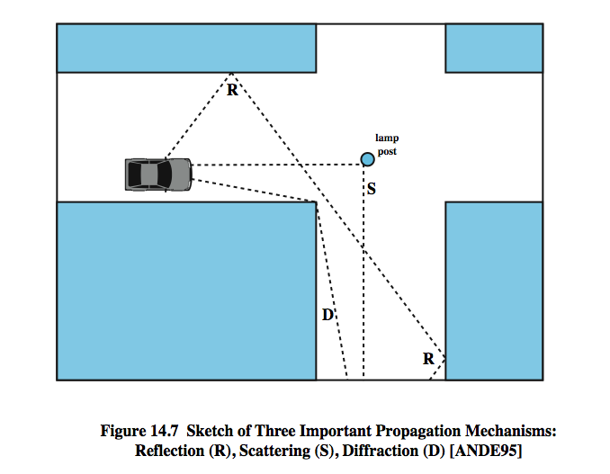
Multipath Propagation
Notes:
Three propagation mechanisms, illustrated in Stallings DCC8e Figure 14.7, play a role. These three propagation effects influence system performance in various ways depending on local conditions and as the mobile unit moves within a cell.
Reflection occurs when an electromagnetic signal encounters a surface that is large relative to the wavelength of the signal. For example, suppose a ground-reflected wave near the mobile unit is received. Because the ground-reflected wave has a 180º phase shift after reflection, the ground wave and the line-of-sight (LOS) wave may tend to cancel, resulting in high signal loss. Further, because the mobile antenna is lower than most human-made structures in the area, multipath interference occurs. These reflected waves may interfere constructively or destructively at the receiver.
Diffraction occurs at the edge of an impenetrable body that is large compared to the wavelength of the radio wave. When a radio wave encounters such an edge, waves propagate in different directions with the edge as the source. Thus, signals can be received even when there is no unobstructed LOS from the transmitter.
If the size of an obstacle is on the order of the wavelength of the signal or less, scattering occurs. An incoming signal is scattered into several weaker outgoing signals. At typical cellular microwave frequencies, there are numerous objects, such as lamp posts and traffic signs, that can cause scattering. Scattering effects are difficult to predict.

Slide 89
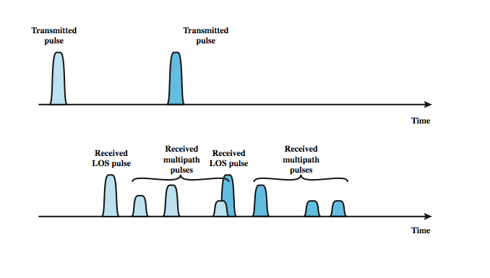
Effects of Multipath Propagation
Notes:
As just noted, one unwanted effect of multipath propagation is that multiple copies of a signal may arrive at different phases. If these phases add destructively, the signal level relative to noise declines, making signal detection at the receiver more difficult. A second phenomenon, of particular importance for digital transmission, is intersymbol interference (ISI). Consider that we are sending a narrow pulse at a given frequency across a link between a fixed antenna and a mobile unit. Stallings DCC8e Figure 14.8 shows what the channel may deliver to the receiver if the impulse is sent at two different times. The upper line shows two pulses at the time of transmission. The lower line shows the resulting pulses at the receiver. In each case the first received pulse is the desired LOS signal. The magnitude of that pulse may change because of changes in atmospheric attenuation. Further, as the mobile unit moves farther away from the fixed antenna, the amount of LOS attenuation increases. But in addition to this primary pulse, there may be multiple secondary pulses due to reflection, diffraction, and scattering. Now suppose that this pulse encodes one or more bits of data. In that case, one or more delayed copies of a pulse may arrive at the same time as the primary pulse for a subsequent bit. These delayed pulses act as a form of noise to the subsequent primary pulse, making recovery of the bit information more difficult. As the mobile antenna moves, the location of various obstacles changes; hence the number, magnitude, and timing of the secondary pulses change. This makes it difficult to design signal processing techniques that will filter out multipath effects so that the intended signal is recovered with fidelity.

Slide 90
Types of Fading
fast fading
  rapid changes in strength over half wavelength distances
    eg. 900MHz wavelength is 0.33m see 20-30dB
slow fading
  slower changes due to user passing different height buildings, gaps in buildings etc.
  over longer distances than fast fading
flat fading
  affects all frequencies in same proportion
selective fading
  different frequency components affected differently
Notes:
Fading effects in a mobile environment can be classified as either fast or slow. Referring to Stallings DCC8e Figure 14.7, as the mobile unit moves down a street in an urban environment, rapid variations in signal strength occur over distances of about one-half a wavelength. At a frequency of 900 MHz, which is typical for mobile cellular applications, a wavelength is 0.33 m. Changes of amplitude can be as much as 20 or 30 dB over a short distance. This type of rapidly changing fading phenomenon, known as fast fading, affects not only mobile phones in automobiles, but even a mobile phone user walking down an urban street. As the mobile user covers distances well in excess of a wavelength, the urban environment changes, as the user passes buildings of different heights, vacant lots, intersections, and so forth. Over these longer distances, there is a change in the average received power level about which the rapid fluctuations occur. This is referred to as slow fading.
Fading effects can also be classified as flat or selective. Flat fading, or nonselective fading, is that type of fading in which all frequency components of the received signal fluctuate in the same proportions simultaneously. Selective fading affects unequally the different spectral components of a radio signal. The term selective fading is usually significant only relative to the bandwidth of the overall communications channel. If attenuation occurs over a portion of the bandwidth of the signal, the fading is considered to be selective; nonselective fading implies that the signal bandwidth of interest is narrower than, and completely covered by, the spectrum affected by the fading.

Slide 91
Error Compensation Mechanisms
forward error correction
  applicable in digital transmission applications
  typically, ratio of total bits to data bits is 2-3
  has a big overhead
adaptive equalization
  applied to transmissions that carry analog or digital information
  used to combat intersymbol interference
  gathering the dispersed symbol energy back together into its original time interval
  techniques include so-called lumped analog circuits and sophisticated digital signal processing algorithms
Notes:
The efforts to compensate for the errors and distortions introduced by multipath fading fall into three general categories: forward error correction, adaptive equalization, and diversity techniques. In the typical mobile wireless environment, techniques from all three categories are combined to combat the error rates encountered.
Forward error correction is applicable in digital transmission applications: those in which the transmitted signal carries digital data or digitized voice or video data. Typically in mobile wireless applications, the ratio of total bits sent to data bits sent is between 2 and 3. This may seem an extravagant amount of overhead, in that the capacity of the system is cut to one-half or one-third of its potential, but the mobile wireless environment is so difficult that such levels of redundancy are necessary. Chapter 6 discusses forward error correction.
Adaptive equalization can be applied to transmissions that carry analog information (e.g., analog voice or video) or digital information (e.g., digital data, digitized voice or video) and is used to combat intersymbol interference. The process of equalization involves some method of gathering the dispersed symbol energy back together into its original time interval. Equalization is a broad topic; techniques include the use of so-called lumped analog circuits as well as sophisticated digital signal processing algorithms.

Slide 92
Error Compensation Mechanisms
diversity
  based on fact that individual channels experience independent fading events
  use multiple logical channels between transmitter and receiver
  send part of signal over each channel
  doesn’t eliminate errors
  reduce error rate
  equalization, forward error correction then cope with reduced error rate
  space diversity involves physical transmission paths
  more commonly refers to frequency or time diversity
Notes:
Diversity is based on the fact that individual channels experience independent fading events. We can therefore compensate for error effects by providing multiple logical channels in some sense between transmitter and receiver and sending part of the signal over each channel. This technique does not eliminate errors but it does reduce the error rate, since we have spread the transmission out to avoid being subjected to the highest error rate that might occur. The other techniques (equalization, forward error correction) can then cope with the reduced error rate.
Some diversity techniques involve the physical transmission path and are referred to as space diversity. For example, multiple nearby antennas may be used to receive the message, with the signals combined in some fashion to reconstruct the most likely transmitted signal. Another example is the use of collocated multiple directional antennas, each oriented to a different reception angle with the incoming signals again combined to reconstitute the transmitted signal. More commonly, the term diversity refers to frequency diversity or time diversity techniques. With frequency diversity, the signal is spread out over a larger frequency bandwidth or carried on multiple frequency carriers.

Slide 93
First Generation Analog
original cellular telephone networks
analog traffic channels
early 1980s in North America
Advanced Mobile Phone Service (AMPS)
also common in South America, Australia, and China
replaced by later generation systems
Notes:
The original cellular telephone networks provided analog traffic channels; these are now referred to as first-generation systems. Since the early 1980s the most common first-generation system in North America has been the Advanced Mobile Phone Service (AMPS) developed by AT&T. This approach is also common in South America, Australia, and China. Although gradually being replaced by second-generation systems, AMPS is still in common use. In this section, we provide an overview of AMPS.

Slide 94
AMPS Spectral Allocation In North America
two 25-MHz bands are allocated to AMPS
  from BS to mobile unit (869–894 MHz)
  from mobile to base station (824–849 MHz)
bands is split in two to encourage competition
operator is allocated only 12.5 MHz in each direction
channels spaced 30 kHz apart (416 channels / operator)
control channels are 10 kbps data channels
voice channels carry analog using frequency modulation
control info also sent on voice channels in bursts as data
number of channels inadequate for most major markets
for AMPS, frequency reuse is exploited
Notes:
In North America, two 25-MHz bands are allocated to AMPS (see Stallings DCC8e Table 14.2), one for transmission from the base station to the mobile unit (869–894 MHz), the other for transmission from the mobile to the base station (824–849 MHz). Each of these bands is split in two to encourage competition (i.e., so that in each market two operators can be accommodated). An operator is allocated only 12.5 MHz in each direction for its system. The channels are spaced 30 kHz apart, which allows a total of 416 channels per operator. Twenty-one channels are allocated for control, leaving 395 to carry calls. The control channels are data channels operating at 10 kbps. The conversation channels carry the conversations in analog using frequency modulation. Control information is also sent on the conversation channels in bursts as data. This number of channels is inadequate for most major markets, so some way must be found either to use less bandwidth per conversation or to reuse frequencies. Both approaches have been taken in the various approaches to mobile telephony. For AMPS, frequency reuse is exploited.

Slide 95
Operation
AMPS-capable phone has numeric assignment module (NAM) in read-only memory
  NAM contains number of phone
  serial number of phone
  when phone turned on, transmits serial number and phone number to MTSO
  MTSO has database of mobile units reported stolen
  MTSO uses phone number for billing
  if phone is used in remote city, service is still billed to user's local service provider
Notes:
Each AMPS-capable cellular telephone includes a numeric assignment module (NAM) in read-only memory. The NAM contains the telephone number of the phone, which is assigned by the service provider, and the serial number of the phone, which is assigned by the manufacturer. When the phone is turned on, it transmits its serial number and phone number to the MTSO (see Stallings DCC8e Figure 14.5); the MTSO maintains a database with information about mobile units that have been reported stolen and uses serial number to lock out stolen units. The MTSO uses the phone number for billing purposes. If the phone is used in a remote city, the service is still billed to the user's local service provider.

Slide 96
AMPS Call Sequence
subscriber initiates call keying in number
MTSO validates telephone number and checks user authorized to place call
MTSO issues message to user's phone indicating traffic channels to use
MTSO sends ringing signal to called party
when called party answers, MTSO establishes circuit and initiates billing information
when one party hangs up MTSO releases circuit, frees radio channels, and completes billing information
Notes:
When a call is placed, the following sequence of events occurs:
1. The subscriber initiates a call by keying in the telephone number of the called party and presses the send key.
2. The MTSO verifies that the telephone number is valid and that the user is authorized to place the call; some service providers require the user to enter a PIN (personal identification number) as well as the called number to counter theft.
3. The MTSO issues a message to the user's cell phone indicating which traffic channels to use for sending and receiving.
4. The MTSO sends out a ringing signal to the called party. All of these operations (steps 2 through 4) occur within 10 s of initiating the call.
5. When the called party answers, the MTSO establishes a circuit between the two parties and initiates billing information.
6. When one party hangs up, the MTSO releases the circuit, frees the radio channels, and completes the billing information.

Slide 97
AMPS Control Channels
21 full-duplex 30-kHz control channels
  transmit digital data using FSK
  data transmitted in frames
control information can be transmitted over voice channel during conversation
  Mmobile unit or the base station inserts burst of data
    turn off voice FM transmission for about 100 ms
    replacing it with an FSK-encoded message
  used to exchange urgent messages
    change power level
    handoff
Notes:
Each AMPS service includes 21 full-duplex 30-kHz control channels, consisting of 21 reverse control channels (RCCs) from subscriber to base station, and 21 forward channels from base station to subscriber. These channels transmit digital data using FSK. In both channels, data are transmitted in frames.
Control information can be transmitted over a voice channel during a conversation. The mobile unit or the base station can insert a burst of data by turning off the voice FM transmission for about 100 ms and replacing it with an FSK-encoded message. These messages are used to exchange urgent messages, such as change power level and handoff.

Slide 98
Personal Communication System (PCS)
Problems with cellular structure
  How to maintain continuous communication between two parties in the presence of mobility?
    Solution: Handoff
  How to maintain continuous communication between two parties in the presence of mobility?
    Solution: Roaming
How to locate of a mobile unit in the entire coverage area?
  Solution: Location management

Slide 99
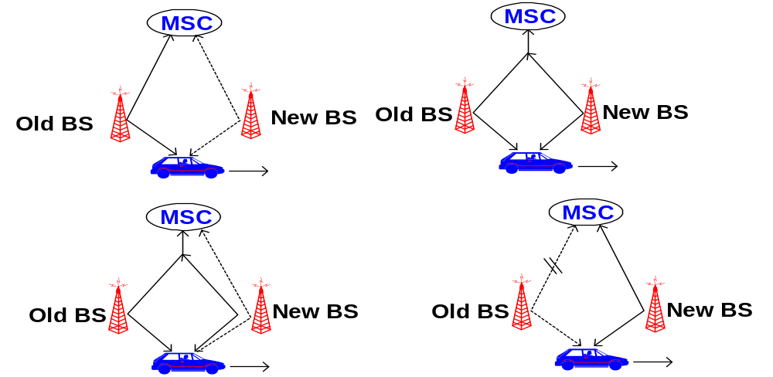
Personal Communication System (PCS)
Handoff
A process, which allows users to remain in touch, even while breaking the connection with one BS and establishing connection with another BS.

Slide 100
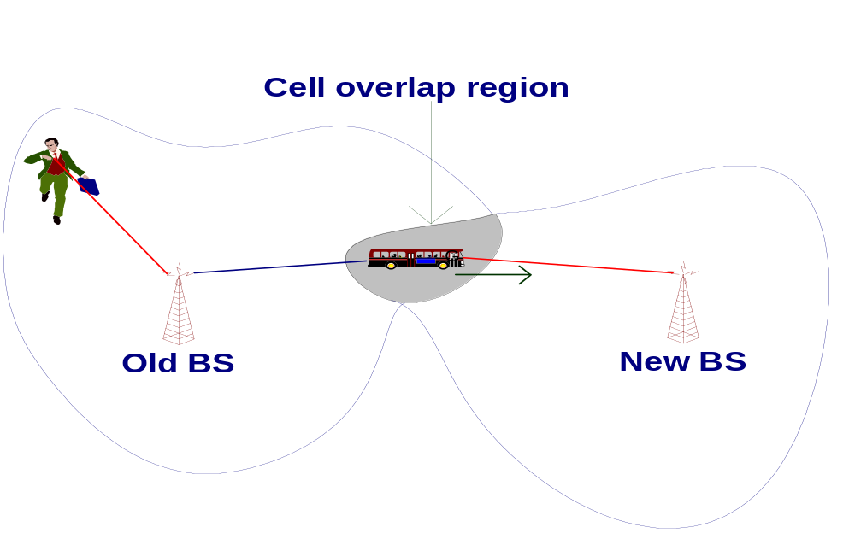
Personal Communication System (PCS)
Handoff
To keep the conversation going, the Handoff procedure should be completed while the MS (the bus) is in the overlap region.

Slide 101
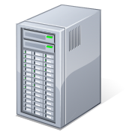
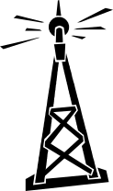


Introduction – Use Case 1
BSC
BS1
BS2
BS3
1. Connect to BS1 and start conversation
2. Moving out of BS1’s coverage – connect to BS2
3. Moving out of BS2’s coverage – connect to BS3
4. Conversation ended – still within BS3’s coverage
Tor K Moseng, Handoff in Wireless Internet Access

Slide 102
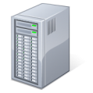
Handover in GSM
Horizontal Handover
Network-controlled, mobile terminal assisted handover
  The network takes the handover decisions
  The mobile terminal supervises and reports its signal quality
Three types of handover
  Intra-BSC handover
  Inter-BSC handover
  Inter-MSC handover
MSC
MSC
BSC
BSC
BSC
BSC
Tor K Moseng, Handoff in Wireless Internet Access
Notes:
MSC: Mobile Switching Centre
Intra-BSC handover
Involves only the BSC
Inter-BSC handover
Signalling up to the MSC
Inter-MSC handover
More complex when handover to another MSC is performed

Slide 103
Handoff Region
Signal strength due to BS_{i}
Signal strength due to BS_{j}
P_{i}(x)
P_{j}(x)
E
P_{min}
BS_{i}
MS
BS_{j}
X₁
X₃
X₅
X_{th}
X₄
X₂
By looking at the variation of signal strength from either base station it is possible to decide on the optimum area where handoff can take place.

Slide 104
Handover decision
receive level
BTS_{old}
receive level
BTS_{old}
HO_MARGIN
MS
MS
BTS_{old}
BTS_{new}
Wireless Networks Spring 2005

Slide 105
Hard Handover
Handover Approaches
”break before make”
Old connection is broken before a new connection is activated
Primarily used in FDMA and TDMA systems (e.g. GSM)
  Different frequency ranges used in adjacent cells to minimize the interference
When to perform hard handover?
  E.g. based on measurements of the signal quality
  Different schemes to avoid unnecessary handovers
Tor K Moseng, Handoff in Wireless Internet Access
Notes:
FDMA: Frequency Division Multiple Access
TDMA: Time Division Multiple Access
Basing the handover on only signal strength is observed to give too many unneccessary handovers
Thresholds may say when signal is sufficiently weak
Margins may say when new signal is stronger by a given margin

Slide 106
Handoff types with reference to link transfer
Hard handoff
The MS connects with only one BS at a time, and there is usually some interruption in the conversation during the link transition.
Soft handoff
The two BSs are briefly simultaneously connected to the MU while crossing the cell boundary. As soon as the mobile's link with the new BS is acceptable, the initial BS disengages from the MU.

Slide 107
Personal Communication System (PCS)
Handoff types with reference to link transfer
Hard handoff
  MU temporarily suspends the voice conversation by sending a link suspend message to the old BS.
  MU sends a handoff request message through an idle time slot of the new BS to the network.
  The new BS sends a handoff ack message and marks the slot busy.
  The MU returns the old assigned channel by sending a link resume message to the old BS.

Slide 108
Personal Communication System (PCS)
Handoff types with reference to link transfer
Hard handoff
  MU continues voice communication while the network prepares for the handoff.
  Upon receipt of a handoff request message, the new BS sends a handoff ack message and reconfigures itself to effect the handoff.
  The MSC inserts a bridge into the conversation path and bridges the new BS.
  Finally, the network informs the MU to execute the handoff via both the new and old BSs by sending the handoff execute message.

Slide 109
Personal Communication System (PCS)
Handoff types with reference to link transfer
Hard handoff
  MU releases the old channel by sending an access release message to the old BS.
  Once the MU has made the transfer to the new BS, it sends the network a handoff complete message through the new channel, and resumes the voice communication. The network removes the bridge from the path and frees up the resources associated with the old channel.

Slide 110
Soft Handover
Handover Approaches
”make before break”
New connection is activated before the old is broken
Used in UMTS to improve the signal quality
  Uplink and downlink signals may be combined for better signal
  A mobile may in UMTS spend a large part of the connection time in soft handover
  Better connection reliability
More seamless handover
Tor K Moseng, Handoff in Wireless Internet Access
Notes:
CDMA (Code Division Multiple Access)
SHO appears to a CDMA-MS as multipath components, but with different spreading codes
When a base station’s signal exceeds a defined threshold, it is added to the active set of base stations in the mobile station
Handovers in CDMA fundamentally different from TDMA
UMTS
Trade-off: Improved mobility but more interference from transmitting same flow over several connections (possibly more Node Bs)

Slide 111
Personal Communication System (PCS)
Handoff types with reference to link transfer
Soft handoff
  MU sends a pilot strength measurement message to the old BS, indicating the new BS to be added.
  The old BS sends a handoff request message to the MSC. If the MSC accepts the handoff request, it sends a handoff request message to the new BS.
  The BS sends a null traffic message to the MU to prepare the establishment of the communication link.

Slide 112
Personal Communication System (PCS)
Handoff types with reference to link transfer
Soft handoff
  The new BS sends a join request message to the MSC. The MSC bridges the connection for the two BSs, so that the handoff can be processed without breaking the connection.
  The new BS sends a handoff ack message to the old BS via the MSC. The old BS instructs the MU to add a link to the new BS by exchanging the handoff command and handoff complete messages.

Slide 113
Personal Communication System (PCS)
Handoff types with reference to link transfer
Soft handoff
  The old BS and the MSC conclude this procedure by exchanging the required handoff information. The quality of the new link is guaranteed by the exchange of the pilot measurement request and the pilot strength measurement message pair between the MU and the new BS.

Slide 114
4 types of handover
1
2
3
4
MS
MS
MS
MS
BTS
BTS
BTS
BTS
BSC
BSC
BSC
MSC
MSC

Slide 115
Personal Communication System (PCS)
Handoff detection strategies
Mobile-Controlled handoff (MCHO)
Network-Controlled handoff (NCHO)
Mobile-Assisted handoff (MAHO)

Slide 116
Personal Communication System (PCS)
Mobile-Controlled Handoff (MCHO)
In this strategy, the MS continuously monitors the radio signal strength and quality of the surrounding BSs. When predefined criteria are met, then the MS checks for the best candidate BS for an available traffic channel and requests the handoff to occur. MACHO is used in DECT and PACS.

Slide 117
Personal Communication System (PCS)
Network-Controlled Handoff (NCHO)
In this strategy, the surrounding BSs, the MSC or both monitor the radio signal. When the signal’s strength and quality deteriorate below a predefined threshold, the network arranges for a handoff to another channel. NCHO is used in CT-2 Plus and AMPS.

Slide 118
Personal Communication System (PCS)
Mobile-Assisted Handoff (MAHO)
It is a variant of NCHO strategy. In this strategy, the network directs the MS to measure the signal from the surrounding BSs and to report those measurements back to the network. The network then uses these measurements to determine where a handoff is required and to which channel. MACHO is used in GSM and IS-95 CDMA.

Slide 119
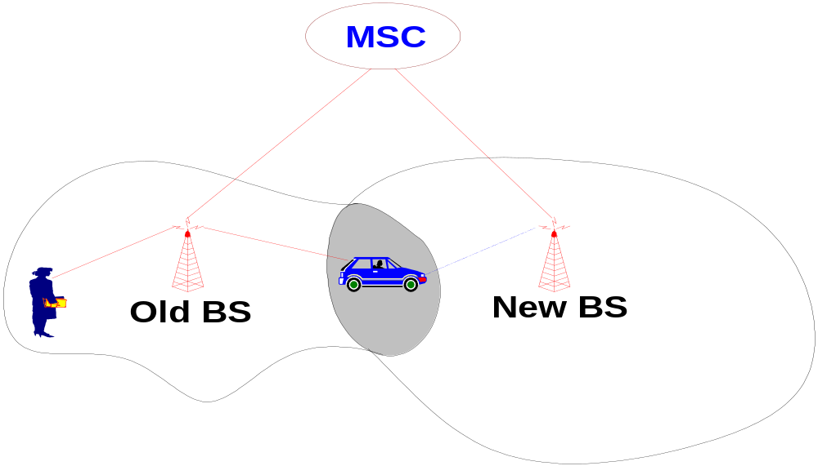
Personal Communication System (PCS)
Handoff types with reference to the network
Intra-system handoff or Inter-BS handoff
The new and the old BSs are connected to the same MSC.

Slide 120
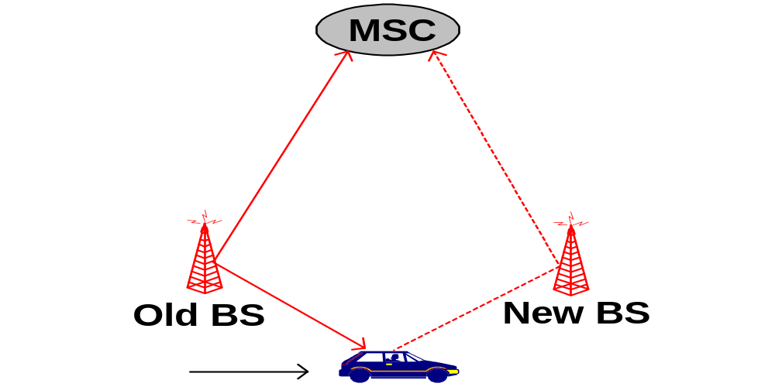
Personal Communication System (PCS)
Intra-system handoff or Inter-BS handoff
Steps
  The MU (MS) momentarily suspends conversation and initiates the handoff procedure by signaling on an idle (currently free) channel in the new BS. Then it resumes the conversation on the old BS.

Slide 121
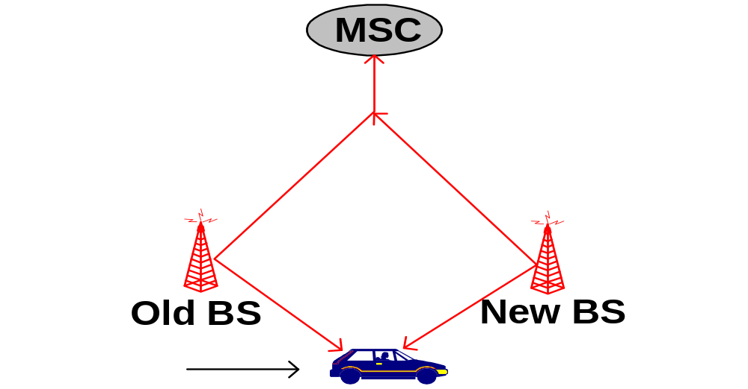
Personal Communication System (PCS)
Intra-system handoff or Inter-BS handoff
Upon receipt of the signal, the MSC transfers the encryption information to the selected idle channel of the new BS and sets up the new conversation path to the MS through that channel. The switch bridges the new path with the old path and informs the MS to transfer from the old channel to the new channel.

Slide 122
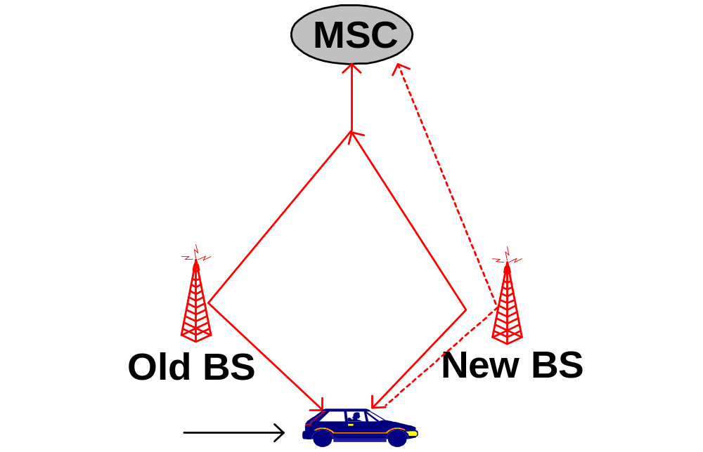
Personal Communication System (PCS)
Intra-system handoff or Inter-BS handoff
After the MS has been transferred to the new BS, it signals the network and resumes conversation using the new channel.

Slide 123

Personal Communication System (PCS)
Intra-system handoff or Inter-BS handoff
Upon the receipt of the handoff completion signal, the network removes the bridge from the path and releases resources associated with the old channel.

Slide 124

Personal Communication System (PCS)
Handoff types with reference to the network
Intersystem handoff or Inter-MSC handoff
The new and the old BSs are connected to different MSCs.

Slide 125
Second Generation CDMA
provide higher quality signals, higher data rates, support digital services, with overall greater capacity
key differences include
  digital traffic channels
  encryption
  error detection and correction
  channel access
    time division multiple access (TDMA)
    code division multiple access (CDMA)
Notes:
Second-generation systems have been developed to provide higher quality signals, higher data rates for support of digital services, and greater capacity. Some key differences between the two generations are:
• Digital traffic channels: second-generation systems are digital. These readily support digital data; voice traffic is first encoded in digital form before transmitting. Of course, for second-generation systems, the user traffic (data or digitized voice) must be converted to an analog signal for transmission between the mobile unit and the base station
• Encryption: Because all of the user traffic, as well as control traffic, is digitized in second-generation systems, it is a relatively simple matter to encrypt all of the traffic to prevent eavesdropping. All second-generation systems provide this capability.
• Error detection and correction: The digital traffic stream of second-generation systems also lends itself to the use of error detection and correction techniques, giving very clear voice reception.
• Channel access: Second-generation systems also provide multiple channels per cell, but each channel is dynamically shared by a number of users using time division multiple access (TDMA) or code division multiple access (CDMA). We look at CDMA-based systems in this section.

Slide 126
Code Division Multiple Access (CDMA)
have a number of 2nd gen systems
  for example IS-95 using CDMA
each cell allocated frequency bandwidth
is split in two
  half for reverse, half for forward
  uses direct-sequence spread spectrum (DSSS)
Notes:
Beginning around 1990, a number of different second-generation systems have been deployed. A good example is the IS-95 scheme using CDMA. CDMA for cellular systems can be described as follows. As with FDMA, each cell is allocated a frequency bandwidth, which is split into two parts, half for reverse (mobile unit to base station) and half for forward (base station to mobile unit). For full duplex communication, a mobile unit uses both reverse and forward channels. Transmission is in the form of direct-sequence spread spectrum (DS-SS), which uses a chipping code to increase the data rate of the transmission, resulting in an increased signal bandwidth. Multiple access is provided by assigning orthogonal chipping codes (defined in Chapter 9) to multiple users, so that the receiver can recover the transmission of an individual unit from multiple transmissions.

Slide 127
Code Division Multiple Access (CDMA) Advantages
frequency diversity
  noise bursts & fading have less effect
multipath resistance
  chipping codes have low cross & auto correlation
privacy
  inherent in use of spread-spectrum
graceful degradation
  more users means more noise
  leads to slow signal degradation until unacceptable
Notes:
CDMA has a number of advantages for a cellular network:
• Frequency diversity: Because the transmission is spread out over a larger bandwidth, frequency-dependent transmission impairments, such as noise bursts and selective fading, have less effect on the signal.
• Multipath resistance: In addition to the ability of DS-SS to overcome multipath fading by frequency diversity, the chipping codes used for CDMA not only exhibit low cross correlation but also low autocorrelation. Therefore, a version of the signal that is delayed by more than one chip interval does not interfere with the dominant signal as much as in other multipath environments.
• Privacy: Because spread spectrum is obtained by the use of noiselike signals, where each user has a unique code, privacy is inherent.
• Graceful degradation: With FDMA or TDMA, a fixed number of users can access the system simultaneously. However, with CDMA, as more users access the system simultaneously, the noise level and hence the error rate increases; only gradually does the system degrade to the point of an unacceptable error rate.

Slide 128
Code Division Multiple Access (CDMA) Disadvantages
self-jamming
  some cross correlation between users
near-far problem
  signals closer to receiver are received with less attenuation than signals farther away
Notes:
Two drawbacks of CDMA cellular should also be mentioned:
• Self-jamming: Unless all of the mobile users are perfectly synchronized, the arriving transmissions from multiple users will not be perfectly aligned on chip boundaries. Thus the spreading sequences of the different users are not orthogonal and there is some level of cross correlation. This is distinct from either TDMA or FDMA, in which for reasonable time or frequency guardbands, respectively, the received signals are orthogonal or nearly so.
• Near-far problem: Signals closer to the receiver are received with less attenuation than signals farther away. Given the lack of complete orthogonality, the transmissions from the more remote mobile units may be more difficult to recover.

Slide 129

RAKE Receiver
Notes:
In a multipath environment, which is common in cellular systems, if the multiple versions of a signal arrive more than one chip interval apart from each other, the receiver can recover the signal by correlating the chip sequence with the dominant incoming signal. The remaining signals are treated as noise. However, even better performance can be achieved if the receiver attempts to recover the signals from multiple paths and then combine them, with suitable delays. This principle is used in the RAKE receiver.
Stallings DCC8e Figure 14.9 illustrates the principle of the RAKE receiver. The original binary signal to be transmitted is spread by the exclusive-OR (XOR) operation with the transmitter's chipping code. The spread sequence is then modulated for transmission over the wireless channel. Because of multipath effects, the channel generates multiple copies of the signal, each with a different amount of time delay (τ₁, τ₂, etc.), and each with a different attenuation factors (a₁, a₂, etc.). At the receiver, the combined signal is demodulated. The demodulated chip stream is then fed into multiple correlators, each delayed by a different amount. These signals are then combined using weighting factors estimated from the channel.

Slide 130
IS-95
second generation CDMA scheme
primarily deployed in North America
transmission structures different on forward and reverse links
Notes:
The most widely used second-generation CDMA scheme is IS-95, which is primarily deployed in North America. The transmission structures on the forward and reverse links differ and are described separately.

Slide 131

IS-95 Channel Structure
Notes:
The forward link consists of up to 64 logical CDMA channels each occupying the same 1228-kHz bandwidth, as shown in Stallings DCC8e Figure 14.10a.

Slide 132
IS-95 Forward Link
four types of channels
  Pilot (channel 0)
    allows mobile unit to acquire timing information
  Synchronization (channel 32)
    1200-bps channel used by mobile station to obtain identification information about the cellular system
  Paging (channels 1 to 7)
    Contain messages for one or more mobile stations
  Traffic (channels 8 to 31 and 33 to 63)
    55 traffic channels
all channels use same bandwidth
Notes:
The forward link supports four types of channels:
• Pilot (channel 0): A continuous signal on a single channel. This channel allows the mobile unit to acquire timing information, provides phase reference for the demodulation process, and provides a means for signal strength comparison for the purpose of handoff determination. The pilot channel consists of all zeros.
• Synchronization (channel 32): A 1200-bps channel used by the mobile station to obtain identification information about the cellular system (system time, long code state, protocol revision, etc.).
• Paging (channels 1 to 7): Contain messages for one or more mobile stations.
• Traffic (channels 8 to 31 and 33 to 63): The forward channel supports 55 traffic channels. The original specification supported data rates of up to 9600 bps. A subsequent revision added a second set of rates up to 14,400 bps.
Note that all of these channels use the same bandwidth. The chipping code is used to distinguish among the different channels. For the forward channel, the chipping codes are the 64 orthogonal 64-bit codes derived from a 64 × 64 matrix known as the Walsh matrix, as discussed in the text.

Slide 133

Forward Link Processing
Notes:
Stallings DCC8e Figure 14.11 shows the processing steps for transmission on a forward traffic channel using rate set 1. For voice traffic, the speech is encoded at a data rate of 8550 bps. After additional bits are added for error detection, the rate is 9600 bps. The full channel capacity is not used when the user is not speaking. During quiet periods the data rate is lowered to as low as 1200 bps. The 2400-bps rate is used to transmit transients in the background noise, and the 4800 bps rate is used to mix digitized speech and signaling data.
The data or digitized speech is transmitted in 20-ms blocks with forward error correction provided by a convolutional encoder with rate 1/2, thus doubling the effective data rate to a maximum of 19.2 kbps. For lower data rates, the encoder output bits (called code symbols) are replicated to yield the 19.2-kbps rate. The data are then interleaved in blocks to reduce the effects of errors by spreading them out.

Slide 134
Forward Link - Scrambling
after interleaver, data scrambled
privacy mask
prevent sending of repetitive patterns
  reduces probability of users sending at peak power at same time
scrambling done by long code
  pseudorandom number from 42-bit shift register
  initialized with user's electronic serial number
  output at a rate of 1.2288 Mbps
Notes:
Following the interleaver, the data bits are scrambled. The purpose of this is to serve as a privacy mask and to prevent the sending of repetitive patterns, which in turn reduces the probability of users sending at peak power at the same time. The scrambling is accomplished by means of a long code that is generated as a pseudorandom number from a 42-bit-long shift register. The shift register is initialized with the user's electronic serial number. The output of the long code generator is at a rate of 1.2288 Mbps, which is 64 times the rate of 19.2 kbps, so only one bit in 64 is selected (by the decimator function). The resulting stream is XORed with the output of the block interleaver.

Slide 135
Forward Link - Power Control
inserts power control info in traffic channel
  to control the power output of antenna
  robs traffic channel of bits at rate of 800 bps by stealing code bits
  800-bps channel carries information directing mobile unit to change output level
  power control stream multiplexed to 19.2 kbps
Notes:
The next step in the processing inserts power control information in the traffic channel, to control the power output of the antenna. The power control function of the base station robs the traffic channel of bits at a rate of 800 bps. These are inserted by stealing code bits. The 800-bps channel carries information directing the mobile unit to increment, decrement, or keep stable its current output level. This power control stream is multiplexed into the 19.2 kbps by replacing some of the code bits, using the long code generator to encode the bits.

Slide 136
Forward Link - DSSS
spreads 19.2 kbps to 1.2288 Mbps
using one row of Walsh matrix
  assigned to mobile station during call setup
  if 0 presented to XOR, 64 bits of assigned row sent
  if 1 presented, bitwise XOR of row sent
final bit rate 1.2288 Mbps
bit stream modulated onto carrier using QPSK
  data split into I and Q (in-phase and quadrature) channels
  data in each channel XORed with unique short code
Notes:
The next step in the process is the DS-SS function, which spreads the 19.2 kbps to a rate of 1.2288 Mbps using one row of the 64 × 64 Walsh matrix. One row of the matrix is assigned to a mobile station during call setup. If a 0 bit is presented to the XOR function, then the 64 bits of the assigned row are sent. If a 1 is presented, then the bitwise XOR of the row is sent. Thus, the final bit rate is 1.2288 Mbps. This digital bit stream is then modulated onto the carrier using a QPSK modulation scheme. Recall from Chapter 5 that QPSK involves creating two bit streams that are separately modulated (see Figure 5.11). In the IS-95 scheme, the data are split into I and Q (in-phase and quadrature) channels and the data in each channel are XORed with a unique short code. The short codes are generated as pseudorandom numbers from a 15-bit-long shift register.

Slide 137
IS-95 Reverse Link
up to 94 logical CDMA channels
  each occupying same 1228-kHz bandwidth
  supports up to 32 access and 62 traffic channels
traffic channels are mobile unique
  each station has unique long code mask based on serial number
    42-bit number, 2⁴² – 1 different masks
    access channel used by mobile to initiate call, respond to paging channel message, and for location update
Notes:
The reverse link consists of up to 94 logical CDMA channels each occupying the same 1228-kHz bandwidth, see Stallings DCC8e Figure 14.10b on previous slide. The reverse link supports up to 32 access channels and up to 62 traffic channels. The traffic channels in the reverse link are mobile unique. Each station has a unique long code mask based on its electronic serial number. The long code mask is a 42-bit number, so there are 2⁴² – 1 different masks. The access channel is used by a mobile to initiate a call, to respond to a paging channel message from the base station, and for a location update.

Slide 138

Reverse
Link
Processing
Notes:
Stallings DCC8e Figure 14.12 shows the processing steps for transmission on a reverse traffic channel using rate set 1. The first few steps are the same as for the forward channel. For the reverse channel, the convolutional encoder has a rate of 1/3, thus tripling the effective data rate to a maximum of 28.8 kbps. The data are then block interleaved. The next step is a spreading of the data using the Walsh matrix. The way in which the matrix is used, and its purpose, are different from that of the forward channel. In the reverse channel, the data coming out of the block interleaver are grouped in units of 6 bits. Each 6-bit unit serves as an index to select a row of the 64 × 64 Walsh matrix (2⁶ = 64), and that row is substituted for the input. Thus the data rate is expanded by a factor of 64/6 to 307.2 kbps. The purpose of this encoding is to improve reception at the base station. Because the 64 possible codings are orthogonal, the block coding enhances the decision-making algorithm at the receiver and is also computationally efficient (see [PETE95] for details). We can view this Walsh modulation as a form of block error-correcting code with (n, k) = (64, 6) and d_{min} = 32. In fact, all distances are 32. The data burst randomizer is implemented to help reduce interference from other mobile stations (see [BLAC99b] for a discussion). The operation involves using the long code mask to smooth the data out over each 20-ms frame.

Slide 139
Reverse Link - DSSS
long code unique to mobile XORed with output of randomizer
1.2288-Mbps final data stream
modulated using orthogonal QPSK modulation
differs from forward channel in use of delay element in modulator to produce orthogonality
  forward channel, spreading codes orthogonal
  reverse channel orthogonality of spreading codes not guaranteed
Notes:
The next step in the process is the DS-SS function. In the case of the reverse channel, the long code unique to the mobile is XORed with the output of the randomizer to produce the 1.2288-Mbps final data stream. This digital bit stream is then modulated onto the carrier using an offset QPSK modulation scheme. This differs from the forward channel in the use of a delay element in the modulator (Figure 5.11) to produce orthogonality. The reason the modulators are different is that in the forward channel, the spreading codes are orthogonal, all coming from the Walsh matrix, whereas in the reverse channel, orthogonality of the spreading codes is not guaranteed.

Slide 140
Third Generation Systems
high-speed wireless communications to support multimedia, data, and video in addition to voice
3G capabilities:
    voice quality comparable to PSTN
    144 kbps available to users over large areas
    384 kbps available to pedestrians over small areas
    support for 2.048 Mbps for office use
    symmetrical and asymmetrical data rates
    packet-switched and circuit-switched services
    adaptive interface to Internet
    more efficient use of available spectrum
    support for variety of mobile equipment
    allow introduction of new services and technologies
Notes:
The objective of the third generation (3G) of wireless communication is to provide fairly high-speed wireless communications to support multimedia, data, and video in addition to voice. The ITU’s International Mobile Telecommunications for the year 2000 (IMT-2000) initiative has defined the ITU’s view of third-generation capabilities as:
• Voice quality comparable to the public switched telephone network
• 144 kbps data rate available to users in high-speed motor vehicles over large areas
• 384 kbps available to pedestrians standing or moving slowly over small areas
• Support (to be phased in) for 2.048 Mbps for office use
• Symmetrical and asymmetrical data transmission rates
• Support for both packet-switched and circuit-switched data services
• An adaptive interface to the Internet to reflect efficiently the common asymmetry between inbound and outbound traffic
• More efficient use of the available spectrum in general
• Support for a wide variety of mobile equipment
• Flexibility to allow the introduction of new services and technologies

Slide 141
Driving Forces
trend toward universal personal telecommunications
universal communications access
GSM cellular telephony with subscriber identity module, is step towards goals
personal communications services (PCSs) and personal communication networks (PCNs) also form objectives for third-generation wireless
technology is digital using time division multiple access or code-division multiple access
PCS handsets low power, small and light
Notes:
More generally, one of the driving forces of modern communication technology is the trend toward universal personal telecommunications and universal communications access. The first concept refers to the ability of a person to identify himself or herself easily and use conveniently any communication system in an entire country, over a continent, or even globally, in terms of a single account. The second refers to the capability of using one’s terminal in a wide variety of environments to connect to information services (e.g., to have a portable terminal that will work in the office, on the street, and on airplanes equally well). This revolution in personal computing will obviously involve wireless communication in a fundamental way.
Personal communications services (PCSs) and personal communication networks (PCNs) are names attached to these concepts of global wireless communications, and they also form objectives for third-generation wireless. Generally, the technology planned is digital using time division multiple access or code division multiple access to provide efficient use of the spectrum and high capacity. PCS handsets are designed to be low power and relatively small and light. Efforts are being made internationally to allow the same terminals to be used worldwide.

Slide 142

IMT-2000 Terrestrial Radio Alternative Interfaces
Notes:
Stallings DCC8e Figure 14.13 shows the alternative schemes that have been adopted as part of IMT-2000. The specification covers a set of radio interfaces for optimized performance in different radio environments. A major reason for the inclusion of five alternatives was to enable a smooth evolution from existing first- and second-generation systems, and reflect the evolution from the second generation. Two of the specifications grow out of the work at the European Telecommunications Standards Institute (ETSI) to develop a UMTS (universal mobile telecommunications system) as Europe's 3G wireless standard. UMTS includes two standards. One of these is known as wideband CDMA, or W-CDMA. This scheme fully exploits CDMA technology to provide high data rates with efficient use of bandwidth. The other European effort under UMTS is known as IMT-TC, or TD-CDMA. This approach is a combination of W-CDMA and TDMA technology. IMT-TC is intended to provide an upgrade path for the TDMA-based GSM systems. Another CDMA-based system, known as cdma2000, has a North American origin. This scheme is similar to, but incompatible with, W-CDMA, in part because the standards use different chip rates. Also, cdma2000 uses a technique known as multicarrier, not used with W-CDMA. Two other interface specifications are shown in Figure 14.13. IMT-SC is primarily designed for TDMA-only networks. IMT-FT can be used by both TDMA and FDMA carriers to provide some 3G services; it is an outgrowth of the Digital European Cordless Telecommunications (DECT) standard.

Slide 143
CDMA Design Considerations – Bandwidth and Chip Rate
dominant technology for 3G systems is CDMA
  3 CDMA schemes, share some design issues
bandwidth (limit channel to 5 MHz)
  5 MHz reasonable upper limit on what can be allocated for 3G
  5 MHz is enough for data rates of 144 and 384 kHz
chip rate
  given bandwidth, chip rate depends on desired data rate, need for error control, and bandwidth limitations
  chip rate of 3 Mbps or more reasonable
Notes:
The dominant technology for 3G systems is CDMA. Although three different CDMA schemes have been adopted, they share some common design issues, such as:
• Bandwidth: An important design goal for all 3G systems is to limit channel usage to 5 MHz. There are several reasons for this goal. On the one hand, a bandwidth of 5 MHz or more improves the receiver's ability to resolve multipath when compared to narrower bandwidths. On the other hand, available spectrum is limited by competing needs, and 5 MHz is a reasonable upper limit on what can be allocated for 3G. Finally, 5 MHz is adequate for supporting data rates of 144 and 384 kHz, the main targets for 3G services.
• Chip rate: Given the bandwidth, the chip rate depends on desired data rate, the need for error control, and bandwidth limitations. A chip rate of 3 Mbps or more is reasonable given these design parameters.

Slide 144
CDMA Design Considerations – Multirate
provision of multiple fixed-data-rate channels to user
different data rates provided on different logical channels
logical channel traffic can be switched independently through wireless fixed networks to different destinations
flexibly support multiple simultaneous applications
efficiently use available capacity by only providing the capacity required for each service
use TDMA within single CDMA channel
or use multiple CDMA codes
Notes:
The term multirate refers to the provision of multiple fixed-data-rate logical channels to a given user, in which different data rates are provided on different logical channels. Further, the traffic on each logical channel can be switched independently through the wireless and fixed networks to different destinations. The advantage of multirate is that the system can flexibly support multiple simultaneous applications from a given user and can efficiently use available capacity by only providing the capacity required for each service. Multirate can be achieved with a TDMA scheme within a single CDMA channel, in which a different number of slots per frame are assigned to achieve different data rates. All the subchannels at a given data rate would be protected by error correction and interleaving techniques (Stallings DCC8e Figure 14.14a). An alternative is to use multiple CDMA codes, with separate coding and interleaving, and map them to separate CDMA channels (Figure 14.14b).

Slide 145

CDMA Multirate
Time and Code Multiplexing
Notes:
All the subchannels at a given data rate would be protected by error correction and interleaving techniques as shown here in Stallings DCC8e Figure 14.14a. An alternative is to use multiple CDMA codes, with separate coding and interleaving, and map them to separate CDMA channels, see Figure 14.14b.

Slide 146
Summary
principles of wireless cellular networks
operation of wireless cellular networks
first-generation analog
second-generation CDMA
third-generation systems
Notes:
Chapter14 summary.

Slide 147

Cellular system Concept
MSC is also called Mobile telephone switching office (MTSO)
Notes:
A basic system comprises :
Cellular subscriber phones
Base station
Mobile switching center
The cellular network is connected to public telephone network.
High capacity is achieved by limiting the coverage of each base station transmitter to a small geographic area is called cell so that the same radio channels may be reused by another base station located some distance away. A sophisticated switching technique called a handoff enables a call to proceed uninterrupted when the user moves from one cell to another.
Each cell uses different freq channels.
Cellaular systems use standard freq plan. The voice and control channels are defined. Normally 95% of channels are used for information communication while only 5% are used for signaling purposes.
Switching system, called handoff, enables call to proceed uninterrupted when the user moves from one cell to another.
Typical MSC handles 100,000 cellular users and 5,000 simultaneous conversations at a time.

Slide 148

Cellular System Architecture

Slide 149
Basics: Structure
Multiple Access
Downlink
Handoff
Uplink
Mobile Station Distributed transceivers
Base Station Fixed transceiver
Cells Different Frequencies or Codes

Slide 150




Basic Cellular System
PSTN/ISDN
Switch

Slide 151
Cellular System: Small Zone
Service area
BS
BS
BS
BS
BS
BS
BS

Slide 152
Complete Cellular Network
A group of local base stations are connected (by wires) to a mobile switching center (MSC). MSC is connected to the rest of the world (normal telephone system).
MSC
Public (Wired)
Telephone
Network
MSC
MSC
MSC

Slide 153
Multiple Access in Cellular Networks

Slide 154
Multiple Transmitters, One Receiver
In many wireless systems, multiple transmitters attempt to communicate with the same receiver.
For example, in cellular systems. Cell phones users in a local area typically communicate with the same cell tower.
How is the limited spectrum shared between these local transmitters?

Slide 155
Multiple Access Method
In such cases, system adopts a multiple access policy.
Three widely-used policies:
  Frequency Division Multiple Access (FDMA)
  Time Division Multiple Access (TDMA)
  Code Division Multiple Access (CDMA)

Slide 156
FDMA
In FDMA, we assume that a base station can receive radio signals in a given band of spectrum, i.e., a range of continuous frequency values.
The band of frequency is broken up into smaller bands, i.e., subbands.
Each transmitter (user) transmits to the base station using radio waves in its own subband.
Cell Phone User 1
Cell Phone User 2
:
:
Cell Phone User N
Frequency
Subbands
Time

Slide 157
FDMA (Cont’d)
A subband is also a range of continuous frequencies, e.g., 824 MHz to 824.1 MHz. The width of this subband is 0.1 MHz = 100 KHz.
When a users is assigned a subband, it transmits to the base station using a sine wave with the center frequency in that band, e.g., 824.05 MHz.

Slide 158
FDMA (Cont’d)
When the base station is tuned to the frequency of a desired user, it receives no portion of the signal transmitted by another in-cell user (using a different frequency).
This way, the multiple local transmitters within a cell do not interfere with each other.

Slide 159
TDMA
In pure TDMA, base station does not split up its allotted frequency band into smaller frequency subbands.
Rather it communicates with the users one-at-a-time, i.e., “round robin” access.
…
User 2
Frequency
Bands
User 1
User 3
User N
Time

Slide 160
TDMA (Cont’d)
Time is broken up into time slots, i.e., small, equal-length intervals.
Assume there are some n users in the cell.
Base station groups n consecutive slots into a frame.
Each user is assigned one slot per frame. This slot assignment stays fixed as long as the user communicates with the base station (e.g., length of the phone conversation).

Slide 161
TDMA (Cont’d)
Example of TDMA time slots for n = 10.
In each time slot, the assigned user transmits a radio wave using a sine wave at the center frequency of the frequency band assigned to the base station.
…
…
…
User
1
User
2
User
10
User
1
User
10
User
1
Slot
Time
Frame

Slide 162
CDMA
CDMA is a more complicated scheme.
Here all users communicate to the receiver at the same time and using the same set of frequencies.
This means they may interfere with each other.
The system is designed to control this interference.
A desired user’s signal is deciphered using a unique code assigned to the user.

Slide 163
Final Points on FDMA/TDMA/CDMA
When users are in the middle of a phone call, the system uses FDMA/TDMA/CDMA to give them access.
But there are only so many frequencies, time-slots, or codes available to share between users in a cell.
If we divide the frequency into too many bands, or use too many time slots, or too many codes, the quality of speech heard by the end user will be unsatisfactory.

Slide 164
Channels
Channel is a general term which refers to a frequency in an FDMA system, a timeslot/frequency combination in TDMA, or a code in CDMA.
This way, a base station has a fixed number of channels and can support only that many simultaneous users.

Slide 165
FDMA (Frequency Division Multiple Access)
Frequency
User n
…
User 2
User 1
Time

Slide 166
FDMA Bandwidth Structure
…
1
2
3
4
n
Frequency
Total bandwidth

Slide 167
FDMA Channel Allocation
Frequency 1
User 1
Frequency 2
User 2
…
…
Frequency n
User n
Mobile Stations
Base Station

Slide 168
TDMA (Time Division Multiple Access)
Frequency
…
User 1
User 2
User n
Time

Slide 169
TDMA Frame Structure
…
1
2
3
4
n
Time
Frame

Slide 170
TDMA Frame Illustration for Multiple Users
User 1
Time 1
Time 2
User 2
…
…
…
Time n
User n
Mobile Stations
Base Station

Slide 171
CDMA (Code Division Multiple Access)
Frequency
.
User 1
.
User 2
.
User n
Time
Code

Slide 172

MS, BS, BSC, MSC, and PSTN
Home phone
PSTN
MSC
…
MSC
BSC
…
BSC
BSC
…
BSC
…
…
…
…
BS
MS
BS
MS
BS
MS
BS
MS
BS
MS
BS
MS
BS
MS
BS
MS

Slide 173
Mobile Switching Centers
Mobile switching centers control and coordinate the cellular network.
They serve as intermediary between base stations that may be handing off users between each other.
Base stations communicate with each via the MSC.
MSC keep track of cell phone user subscription.
MSC connects to the wired phone network (rest of the world).

Slide 174
Cellular Systems Terms
Mobile Station
  users transceiver terminal (handset, mobile)
Base Station (BS)
  fixed transmitter usually at centre of cell
  includes an antenna, a controller, and a number of receivers
Mobile Telecommunications Switching Office (MTSO) /Mobile Switch Center (MSC)
  handles routing of calls in a service area
  tracks user
  connects to base stations and PSTN

Slide 175
Cellular Systems Terms (Cont’d)
Two types of channels available between mobile unit and BS
  Control channels – used to exchange information for setting up and maintaining calls
  Traffic channels – carry voice or data connection between users
Handoff or handover
  process of transferring mobile station from one base station to another, may also apply to change of radio channel within a cell

Slide 176
Cellular Systems Terms (Cont’d)
Downlink or Forward Channel
  radio channel for transmission of information (e.g.speech) from base station to mobile station
Uplink or Reverse Channel
  radio channel for transmission of information (e.g.speech) from mobile station to base station
Paging
  a message broadcast over an entire service area, includes use for mobile station alert (ringing)
Roaming
  a mobile station operating in a service area other than the one to which it subscribes

Slide 177
Steps in an MTSO Controlled Call between Mobile Users
Mobile unit initialization
Mobile-originated call
Paging
Call accepted
Ongoing call
Handoff

Slide 178
GSM Specifications-1
RF Spectrum
GSM 900
Mobile to BTS (uplink): 890-915 Mhz
BTS to Mobile(downlink):935-960 Mhz
Bandwidth : 2* 25 Mhz
GSM 1800
Mobile to BTS (uplink): 1710-1785 Mhz
BTS to Mobile(downlink) 1805-1880 Mhz
Bandwidth : 2* 75 Mhz

Slide 179
GSM Specification-II
Carrier Separation : 200 Khz
Duplex Distance : 45 Mhz
No. of RF carriers : 124
Access Method : TDMA/FDMA
Modulation Method : GMSK
Modulation data rate : 270.833 Kbps

Slide 180

Control and Traffic Channels
Forward (downlink) control channel
Reverse (uplink) control channel
Forward (downlink) traffic channel
Reverse (uplink) traffic channel
Mobile Station
Base Station

Slide 181
Steps for a Call Setup from MS to BS
BS
MS
1. Need to establish path
2. Frequency/time slot/code assigned
(FDMA/TDMA/CDMA)
3. Control Information Acknowledgement
4. Start communication

Slide 182
Steps for a Call Setup from BS to MS
BS
MS
1. Call for MS # pending
2. Ready to establish a path
3. Use frequency/time slot/code
(FDMA/TDMA/CDMA)
4. Ready for communication
5. Start communication

Slide 183
The AMPS System
AMPS uses FDMA: a service provider is given license to 832 frequencies to use across a geographic region, say a city.
Service provider chops up the city into cells.
Each cell is roughly 10 square miles.
Each cell has a base station that consists of a tower and a small building containing radio equipment.

Slide 184
The AMPS System (Cont’d)
AMPS uses frequency duplexing, i.e., each cell phone uses one frequency to transmit on and another frequency to receive on.
Total 832 channels are divided into half.
One half is used on the uplink, i.e., used by cell phones to transmit to the base station.
The other half is used on the downlink, i.e., used by the base to transmit to cell phone users.

Slide 185
Voice and Control Channels
Of the 832/2 = 416 channels, 21 of them used as control channels.
This means that there are 416-21=395 voice channels.
Now, these voice channels are divided up among the cells based on the frequency reuse.

Slide 186

AMPS: Voice Channels
Control
Channels
Voice
Channels
Control
Channels

Slide 187
Handoff (Handover) Process
Handoff: Changing physical radio channels of network connections involved in a call, while maintaining the call
Basic reasons for a handoff
  MS moves out of the range of a BTS (signal level becomes too low or error rate becomes too high)
  Load balancing (traffic in one cell is too high, and shift some MSs to other cells with a lower load)
  GSM standard identifies about 40 reasons for a handoff!

Slide 188
Phases of Handoff
MONITORING PHASE
- measurement of the quality of the current and possible candidate radio links
- initiation of a handover when necessary
HANDOVER HANDLING PHASE
- determination of a new point of attachment
- setting up of new links, release of old links
- initiation of a possible re-routing procedure

Slide 189
Handoff Types
Intra-cell handoff
– narrow-band interference => change carrier frequency
– controlled by BSC
Inter-cell, intra-BSC handoff
– typical handover scenario
– BSC performs the handover, assigns new radio channel in the
new cell, releases the old one
Inter-BSC, intra-MSC handoff
– handoff between cells controlled by different BSCs
– controlled by the MSC
Inter-MSC handoff
– handoff between cells belonging to different MSCs
– controlled by both MSCs

Slide 190

Handoff Types (cont’d)

Slide 191
Handoff Strategies
Relative signal strength
Relative signal strength with threshold
Relative signal strength with hysteresis
Relative signal strength with hysteresis and threshold
Prediction techniques

Slide 192

Intra-MSC Handoff (Mobile Assisted)

Slide 193

Handover Scenario at Cell Boundary

Slide 194

Handoff Based on Receive Level
How to avoid ping-pong problem?

Slide 195
Handoff – 1G (Analog) systems
Signal strength measurements made by the BSs and supervised by the MSC
BS constantly monitors the signal strengths of all the voice channels
Locator receiver measures signal strength of MSs in neighboring cells
MSC decides if a handover is necessary

Slide 196
Handoff – 2G (Digital) TDMA
Handoff decisions are mobile assisted
Every MS measures the received power from surrounding BSs and sends reportsto its own BS
Handoff is initiated when the power received from a neighbor BS begins to exceed the power from the current BS (by a certain level and/or for a certain period)

Slide 197
Handoff – 2G (Digital) CDMA
CDMA uses code to differentiate users
Soft handoff: a user keeps records of several neighboring BSs
Soft handoff may decrease the handoff blocking probability and handoff delay

Slide 198

Avoiding handoff: Umbrella cells

Slide 199

Mixed Cell Architecture

Slide 200
Handoff Prioritization
The idea of reserving channels for handoff calls was introduced in the mid 1980s as a way of reducing the handoff call blocking probability
Motivation: users find calls blocked in mid-progress a far greater irritant than unsuccessful call attempts.
The basic idea is to reserve a certain portion of the total channel pool in a cell for handoff users only.

Slide 201
Performance Metrics
Call blocking probability – probability of a new call being blocked
Call dropping probability – probability that a call is terminated due to a handoff
Call completion probability – probability that an admitted call is not dropped before it terminates
Handoff blocking probability – probability that a handoff cannot be successfully completed

Slide 202
Personal Communication System (PCS)
Wireless Components
Base Station (BS): A network element that interconnects the mobile station (or Mobile unit (MU)) to the network via the air interface. Each cell in the network has a BS associated with it. The primary function of a BS is to maintain the air interface, or medium, for communication to any mobile unit within its cell. Other functions of BS are call processing, signaling, maintenance, and diagnostics. The BS communicates to its mobile unit via the air interface, and to MTSO by dedicated communication link such as T1 trunks. Communication links on the BS to the MTSO interface are also classified into voice links and signaling link.

Slide 203
Personal Communication System (PCS)
Wireless Components
Mobile Units (MU): Also called Mobile Systems (MS) or Mobile Hosts (MH). It consists of three components: (a) transceiver, (b) antenna, and (c) user interface. The user interface exists only at MU, which consists of a display, a keypad for entering information, and an audio interface for speaking and hearing voice conversation. This can be a laptop, a palmtop, or a cell phone, or any other mobile device. A MU also stores (a) Mobile Identification Number (MIN), (b) Electronic Serial Number (EIN), and (C) Station Class Mark (SCM). These are transmitted upon power on, cell initiated sampling, and cell origination.

Slide 204

Personal Communication System (PCS)
Wireless Components

Slide 205
Personal Communication System (PCS)
Limited channels must be utilized efficiently. It is done so by (a) Frequency reuse and (b) Mobile cell
  Frequency reuse
    The goal of every mobile service provider is to manage as many simultaneous calls as possible. In USA each cellular provider is allocated 25 MHz of spectrum, 12.5 MHz for transmitting (downstream) and 12.5 MHz for receiving (upstream). Cellular system is duplex because transmitting and receiving are allocated their own frequencies. A person on a mobile call only needs the allocated frequency of the cell, thus there is no reason somebody else on the other end of the town cannot be using the same frequency in a different cell. The concept of multiple users using the same frequency at the same time for communication is called frequency reuse.

Slide 206
Personal Communication System (PCS)
Wireless Components
Base Station (BS): A network element that interconnects the mobile station (or Mobile unit (MU)) to the network via the air interface. Each cell in the network has a BS associated with it. The primary function of a BS is to maintain the air interface, or medium, for communication to any mobile unit within its cell. Other functions of BS are call processing, signaling, maintenance, and diagnostics. The BS communicates to its mobile unit via the air interface, and to MTSO by dedicated communication link such as T1 trunks. Communication links on the BS to the MTSO interface are also classified into voice links and signaling link.

Slide 207
Personal Communication System (PCS)
Wireless Components
Mobile Units (MU): Also called Mobile Systems (MS) or Mobile Hosts (MH). It consists of three components: (a) transceiver, (b) antenna, and (c) user interface. The user interface exists only at MU, which consists of a display, a keypad for entering information, and an audio interface for speaking and hearing voice conversation. This can be a laptop, a palmtop, or a cell phone, or any other mobile device. A MU also stores (a) Mobile Identification Number (MIN), (b) Electronic Serial Number (EIN), and (C) Station Class Mark (SCM). These are transmitted upon power on, cell initiated sampling, and cell origination.

Slide 208
Personal Communication System (PCS)
Wireless Components

Slide 209
Personal Communication System (PCS)
  Frequency reuse (continued)
    For frequency reuse to work correctly it is imperative that each base station has just sufficient power to reach its cell boundary. If it puts out too much power, then it will not only reach the intended cell site, it will reach unintended cell sites, which others may be using at the same frequency for a totally different conversation. This limitation on transmitted power, however, is also an advantage because the cellular phone’s battery will last longer.

Slide 210
Personal Communication System (PCS)
Mobile cell
  Within the cellular allocation the USA is divided into Metropolitan Statistical Areas (MSAs) and Rural Statistical Areas (RSAs). There are six PCS service providers authorized to provide mobile service in each of these areas. Within their geographical region, each service provider divides their area into smaller segments called cells. Each of this cell has a Base Station. Ideally, the system has a large number of very small hexagons (cell). The greater the number of hexagons, the more simultaneous calls the system can handle. However, larger number of hexagons increases the cost of implementation. Thus, cell coverage is a dynamic activity, which is constantly changing in response to increases in demand.

Slide 211
Personal Communication System (PCS)
Mobile cells

Slide 212
Personal Communication System (PCS)
Mobile-Assisted Handoff (MAHO)
It is a variant of NCHO strategy. In this strategy, the network directs the MS to measure the signal from the surrounding BSs and to report those measurements back to the network. The network then uses these measurements to determine where a handoff is required and to which channel. MACHO is used in GSM and IS-95 CDMA.

Slide 213
Personal Communication System (PCS)
Handoff types with reference to the network
Intra-system handoff or Inter-BS handoff
The new and the old BSs are connected to the same MSC.

Slide 214
Personal Communication System (PCS)
Intra-system handoff or Inter-BS handoff
Steps
  The MU (MS) momentarily suspends conversation and initiates the handoff procedure by signaling on an idle (currently free) channel in the new BS. Then it resumes the conversation on the old BS.

Slide 215
Personal Communication System (PCS)
Intra-system handoff or Inter-BS handoff
Upon receipt of the signal, the MSC transfers the encryption information to the selected idle channel of the new BS and sets up the new conversation path to the MS through that channel. The switch bridges the new path with the old path and informs the MS to transfer from the old channel to the new channel.

Slide 216
Personal Communication System (PCS)
Intra-system handoff or Inter-BS handoff
After the MS has been transferred to the new BS, it signals the network and resumes conversation using the new channel.

Slide 217
Personal Communication System (PCS)
Intra-system handoff or Inter-BS handoff
Upon the receipt of the handoff completion signal, the network removes the bridge from the path and releases resources associated with the old channel.

Slide 218
Personal Communication System (PCS)
Handoff types with reference to the network
Intersystem handoff or Inter-MSC handoff
The new and the old BSs are connected to different MSCs.

Slide 219
Personal Communication System (PCS)
Handoff types with reference to link transfer
Hard handoff
The MS connects with only one BS at a time, and there is usually some interruption in the conversation during the link transition.
Soft handoff
The two BSs are briefly simultaneously connected to the MU while crossing the cell boundary. As soon as the mobile's link with the new BS is acceptable, the initial BS disengages from the MU.

Slide 220
Personal Communication System (PCS)
Handoff types with reference to link transfer
Hard handoff
  MU temporarily suspends the voice conversation by sending a link suspend message to the old BS.
  MU sends a handoff request message through an idle time slot of the new BS to the network.
  The new BS sends a handoff ack message and marks the slot busy.
  The MU returns the old assigned channel by sending a link resume message to the old BS.

Slide 221
Personal Communication System (PCS)
Handoff types with reference to link transfer
Hard handoff
  MU continues voice communication while the network prepares for the handoff.
  Upon receipt of a handoff request message, the new BS sends a handoff ack message and reconfigures itself to effect the handoff.
  The MSC inserts a bridge into the conversation path and bridges the new BS.
  Finally, the network informs the MU to execute the handoff via both the new and old BSs by sending the handoff execute message.

Slide 222
Personal Communication System (PCS)
Handoff types with reference to link transfer
Hard handoff
  MU releases the old channel by sending an access release message to the old BS.
  Once the MU has made the transfer to the new BS, it sends the network a handoff complete message through the new channel, and resumes the voice communication. The network removes the bridge from the path and frees up the resources associated with the old channel.

Slide 223
Personal Communication System (PCS)
Handoff types with reference to link transfer
Soft handoff
  MU sends a pilot strength measurement message to the old BS, indicating the new BS to be added.
  The old BS sends a handoff request message to the MSC. If the MSC accepts the handoff request, it sends a handoff request message to the new BS.
  The BS sends a null traffic message to the MU to prepare the establishment of the communication link.

Slide 224
Personal Communication System (PCS)
Handoff types with reference to link transfer
Soft handoff
  The new BS sends a join request message to the MSC. The MSC bridges the connection for the two BSs, so that the handoff can be processed without breaking the connection.
  The new BS sends a handoff ack message to the old BS via the MSC. The old BS instructs the MU to add a link to the new BS by exchanging the handoff command and handoff complete messages.

Slide 225
Handoffs
A crucial component of the cellular concept is the notion of handoffs.
Mobile phone users are by definition mobile, i.e., they move around while using the phone.
Thus, the network should be able to give them continuous access as they move.
This is not a problem when users move within the same cell.
When they move from one cell to another, a handoff is needed.

Slide 226
A Handoff
A user is transmitting and receiving signals from a given base station, say B₁.
Assume the user moves from the coverage area of one base station into the coverage area of a second base station, B₂.
B₁ notices that the signal from this user is degrading.
B₂ notices that the signal from this user is improving.

Slide 227
A Handoff (Cont’d)
At some point, the user’s signal is weak enough at B₁ and strong enough at B₂ for a handoff to occur.
Specifically, messages are exchanged between the user, B₁, and B₂ so that communication to/from the user is transferred from B₁ to B₂.

Slide 228
Cellular Network Organization
Use multiple low-power transmitters
Areas divided into cells
  Each served by its own antenna
  Served by base station consisting of transmitter, receiver, and control unit
  Band of frequencies allocated
  Cells set up such that antennas of all neighbors are equidistant

Slide 229
Consequences
Transmit frequencies are re-used across these cells and the system becomes interference rather than noise limited
  the need for careful radio frequency planning – colouring in hexagons!
  a mechanism for handling the call as the user crosses the cell boundary - call handoff (or handover)
  increased network complexity to route the call and track the users as they move around
But one significant benefit: very much increased traffic capacity, the ability to service many users

Slide 230
Mobile phone features
Basic Features of Mobile phones
  Voice Communications
  Short messaging system (SMS) text messages
Advanced features
  Internet browsing, music (MP3) playback,
  personal organizers/ e-mail,
  built-in cameras and camcorders,
  ringtones, games, radio
  Push-to-Talk (PTT),
  infrared and Bluetooth connectivity, call registers
  ability to watch streaming video or download video for later viewing,
  and serving as a wireless modem for a PC.

Slide 231
Definition of Mobile and Portable
Mobile
  Previously
    any Radio Terminal that could be moved during operation.
  Now
    Radio Terminal that is attached to a high speed mobile platform.
Portable
  as a Radio Terminal that can be hand-held and used by someone at walking speed: Cordless Telephone at home, or walkie talkie
Subscriber – Mobile or portable user.Each user’s communication device is called Subscriber unit.
Base stations – Links mobiles to a backbone network.

Slide 232
Wireless Mobile Communication
Introduction to Wireless Communication System
Fundamental of cellular concept
(Frequency reuse, Channel assignments, Interference and System capacity, Trunking grade of service, capacity improvement)
Radio Propagation
Modulation and Coding

Slide 233
Wireless Mobile Communication
Link improvement techniques
Multiple Access Techniques
Wireless Networking
Wireless System and Standards
Physical layer-Trans-medium-receiver
Data link layer- reliability-error correction-multiple access
Network layer-routing-QoS-flow/congestion control

Slide 234
An Important Technology
Cellular telephony is one of the fastest growing technologies on the planet.
Presently, we are starting to see the third generation of the cellular phones coming to the market.
New phones allow users to do much more than hold phone conversations.

Slide 235
Mobile Telephony Overview
The first generation of wireless telephony began as cellular service in the 1960’s
We are now somewhere between the second (2G) and third (3G) generations
There are multiple standards/providers of service in the USA and across the world
There is little interoperability in handsets, but hand-off systems allow calls to move among the different wireless and wireline networks

Slide 236
The History of Mobile Radio Communication (1/3)
1880: Hertz – Initial demonstration of practical radio communication
1897: Marconi – Radio transmission to a tugboat over an 18 mi path
1921: Detroit Police Department: -- Police car radio dispatch (2 MHz frequency band)
1933: FCC (Federal Communications Commission) – Authorized four channels in the 30 to 40 MHz range
1938: FCC – Ruled for regular service
1946: Bell Telephone Laboratories – 152 MHz (Simplex)
1956: FCC – 450 MHz (Simplex)
1959: Bell Telephone Laboratories – Suggested 32 MHz band for high capacity mobile radio communication
1964: FCC – 152 MHz (Full Duplex)
1964: Bell Telephone Laboratories – Active research at 800 MHz
1969: FCC – 450 MHz (Full Duplex)
1974: FCC – 40 MHz bandwidth allocation in the 800 to 900 MHz range
1981: FCC – Release of cellular land mobile phone service in the 40 MHz bandwidth in the 800 to 900 MHz range for commercial operation

Slide 237
The History of Mobile Radio Communication (2/3)
1981: AT&T and RCC (Radio Common Carrier) reach an agreement to split 40 MHz spectrum into two 20 MHz bands. Band A belongs to nonwireline operators (RCC), and Band B belongs to wireline operators (telephone companies). Each market has two operators.
1982: AT&T is divested, and seven RBOCs (Regional Bell Operating Companies) are formed to manage the cellular operations
1982: MFJ (Modified Final Judgment) is issued by the government DOJ. All the operators were prohibited to (1) operate long-distance business, (2) provide information services, and (3) do manufacturing business
1983: Ameritech system in operation in Chicago
1984: Most RBOC markets in operation
1986: FCC allocates 5 MHz in extended band
1987: FCC makes lottery on the small MSA and all RSA licenses
1988: TDMA (Time Division Multiple Access) voted as a digital cellular standard in North America
1992: GSM (Groupe Speciale Mobile) operable in Germany D2 system

Slide 238
The History of Mobile Radio Communication (3/3)
1993: CDMA (Code Division Multiple Access) voted as another digital cellular standard in North America
1994: American TDMA operable in Seattle, Washington
1994: PDC (Personal Digital Cellular) operable in Tokyo, Japan
1994: Two of six broadband PCS (Personal Communication Service) license bands in auction
1995: CDMA operable in Hong Kong
1996: US Congress passes Telecommunication Reform Act Bill
1996: The auction money for six broadband PCS licensed bands (120 MHz) almost reaches 20 billion US dollars
1997: Broadband CDMA considered as one of the third generation mobile communication technologies for UMTS (Universal Mobile Telecommunication Systems) during the UMTS workshop conference held in Korea
1999: ITU (International Telecommunication Union) decides the next generation mobile communication systems
(e.g., W-CDMA, cdma2000, etc)

Slide 239
Applications
Washington, DC
Cincinnati, OH
Maintaining the telephone number across geographical areas in a wireless and mobile system

Slide 240
Cellular System Infrastructure
Service area (Zone)
BS
Early wireless system: Large zone

Slide 241
First Generation Cellular Systems and Services
1970s | Developments of radio and computer technologies for 800/900 MHz mobile communications
1976 | WARC (World Administrative Radio Conference) allocates spectrum for cellular radio
1979 | NTT (Nippon Telephone & Telegraph) introduces the first cellular system in Japan
1981 | NMT (Nordic Mobile Telephone) 900 system introduced by Ericsson Radio System AB and deployed in Scandinavia
1984 | AMPS (Advanced Mobile Phone Service) introduced by AT&T in North America

Slide 242
Second Generation Cellular Systems and Services
1982 | CEPT (Conference Europeenne des Post et Telecommunications) established GSM to define future Pan-European Cellular Radio Standards
1990 | Interim Standard IS-54 (USDC) adopted by TIA (Telecommunications Industry Association)
1990 | Interim Standard IS-19B (NAMPS) adopted by TIA
1991 | Japanese PDC (Personal Digital Cellular) system standardized by the MPT (Ministry of Posts and Telecommunications)
1992 | Phase I GSM system is operational
1993 | Interim Standard IS-95 (CDMA) adopted by TIA
1994 | Interim Standard IS-136 adopted by TIA
1995 | PCS Licenses issued in North America
1996 | Phase II GSM operational
1997 | North American PCS deploys GSM, IS-54, IS-95
1999 | IS-54: North America IS-95: North America, Hong Kong, Israel, Japan, China, etc GSM: 110 countries

Slide 243
Third Generation Cellular Systems and Services (1/2)
IMT-2000 (International Mobile Telecommunications-2000):
- Fulfill one's dream of anywhere, anytime communications a reality.
Key Features of IMT-2000 include:
- High degree of commonality of design worldwide;
- Compatibility of services within IMT-2000 and with the fixed networks;
- High quality;
- Small terminal for worldwide use;
- Worldwide roaming capability;
- Capability for multimedia applications, and a wide range of services and terminals.

Slide 244
Third Generation Cellular Systems and Services (2/2)
Important Component of IMT-2000 is ability to provide high bearer rate capabilities:
- 2 Mbps for fixed environment;
- 384 Kbps for indoor/outdoor and pedestrian environments;
- 144 kbps for vehicular environment.
Standardization Work:
- Release 1999 specifications
- In processing
Scheduled Service:
- Started in October 2001 in Japan (W-CDMA)

Slide 245
China Leads World in Mobile Phone Users
Total Mobile Users > 800 million
Total Analogue Users > 70 million
ZDNet UK reports that the number of mobile phone users in China reached 167 million in April, 2002, a rise of 6 million subscribers on March, 2002.
The US, which is the second biggest market, has 136 million subscribers.
Mobile phones are the preferred mode of communication in Japan, with 56.8 million subscribers as of the end of March, 2003.

Slide 246
Coverage Aspect of Next Generation Mobile Communication Systems
Satellite
In-Building
Urban
Suburban
Global
Picocell
Microcell
Macrocell
Global

Slide 247



Mobile Telephone Reference Diagram
VLR
PSTN
MSC
MTSO
MS
POTS
BTS/BSC
MS: mobile subscriber
BTS: base terminal station
BSC: base station controller
MSC: mobile switching center
MTSO: mobile telephone switching office
HLR: home location register
VLR: visitor location register
PSTN: public switched telephone network
POTS: plain old telephone service
HLR
BTS/BSC
MS

Slide 248
Mobile Telephony Benefits
Very high mobility and connectivity (one-to -many and many-to-many)
Competitive market place – many vendors offering packages which promote cost-savings, reliability, coverage and user features
Handsets are multi-functional – voice, data, video capture, email, contacts, reminders, games, caller ID, speaker phone, PTT, MP3/ACC players, blue tooth, voice recognition, video messaging

Slide 249
Mobile Telephony Standards
Access Standard | Company | Provides | What’s Coming | Will Provide
CDMA / TIA 95 | Verizon | Voice, Data, PTT, 1xRTT | 1XEV-DO CDMA-2000 | 300-500 kbps, to 2.4 Mbps
TDMA / TIA 136 | Cingular / AT&T | Voice, Data | Edge | 384 kbps data
CDMA / PCS | Sprint | Voice, Data | 1XEV-DV | to 3.1 Mbps
TDMA / iDEN | Nextel | Voice, Data, PTT | Spectrum change | Address public safety concern
GSM | T-Mobile, AT&T | Voice, Data | GPRS, W-CDMA, PTT | 115 kbps data

Slide 250
Beyond Voice
Store contact information
Make task/to-do lists
Keep track of appointments
Calculator
Send/receive email
Send/receive pictures
Send/receive video clips
Get information from the internet
Play games
Integrate with other devices (PDA’s, MP3 Players, etc.)

Slide 251
Outline for Today
Today, we will review the design of cellular system: what are its key components, what it is designed like, and why.
Also, we will look at how cellular networks support multiple cell phone users at a time.
Finally, we will review the important generations of cellular systems and start looking at the design of the first generation of cell phones.

Slide 252
The Cellular Concept

Slide 253
Basic Concept
Cellular system developed to provide mobile telephony: telephone access “anytime, anywhere.”
First mobile telephone system was developed and inaugurated in the U.S. in 1945 in St. Louis, MO.
This was a simplified version of the system used today.

Slide 254
System Architecture
A base station provides coverage (communication capabilities) to users on mobile phones within its coverage area.
Users outside the coverage area receive/transmit signals with too low amplitude for reliable communications.
Users within the coverage area transmit and receive signals from the base station.
The base station itself is connected to the wired telephone network.

Slide 255

First Mobile Telephone System
One and only one
high power base
station with which all
users communicate.
Normal
Telephone
System
Entire Coverage
Area
Wired connection

Slide 256
Problem with Original Design
Original mobile telephone system could only support a handful of users at a time…over an entire city!
With only one high power base station, users phones also needed to be able to transmit at high powers (to reliably transmit signals to the distant base station).
Car phones were therefore much more feasible than handheld phones, e.g., police car phones.

Slide 257
Improved Design
Over the next few decades, researchers at AT&T Bell Labs developed the core ideas for today’s cellular systems.
Although these core ideas existed since the 60’s, it was not until the 80’s that electronic equipment became available to realize a cellular system.
In the mid 80’s the first generation of cellular systems was developed and deployed.

Slide 258
The Core Idea: Cellular Concept
The core idea that led to today’s system was the cellular concept.
The cellular concept: multiple lower-power base stations that service mobile users within their coverage area and handoff users to neighboring base stations as users move. Together base stations tessellate the system coverage area.

Slide 259
Cellular Concept
Thus, instead of one base station covering an entire city, the city was broken up into cells, or smaller coverage areas.
Each of these smaller coverage areas had its own lower-power base station.
User phones in one cell communicate with the base station in that cell.

Slide 260
3 Core Principles
Small cells tessellate overall coverage area.
Users handoff as they move from one cell to another.
Frequency reuse.

Slide 261
Frequency planning II
f₃
f₃
f₃
f₂
f₂
f₁
f₁
f₁
f₃
f₃
3 cell cluster
f₂
f₂
f₂
f₁
f₁
f₃
f₃
f₃
f₂
f₃
f₇
f₅
f₂
f₄
f₆
f₅
7 cell cluster
f₁
f₄
f₃
f₇
f₁
f₂
f₃
f₆
f₅
f₂
f₁
f₂
f₁
f₂
f₁
f₂
f₃
h₁
h₂
f₃
h₁
h₂
f₃
3 cell cluster
with 3 sector antennas
g₁
g₂
h₃
g₁
g₂
h₃
g₁
g₂
g₃
g₃
g₃
Mobile Communication: Wireless Transmission
2.37.1

Slide 262
Hybrid FDMA/TDMA (Cont’d)
Assume a base station divides its frequency band into
4 subbands and time into 10 slots per frame.
…
…
…
User 31
User 32
User 40
User 31
Frequency Subband 4
User 32
User 40
…
…
…
Frequency Subband 3
User 21
User 21
User 22
User 30
User 22
User 30
…
…
…
Frequency Subband 2
User 11
User 11
User 12
User 20
User 12
User 20
…
…
…
User 1
User 1
User 2
User 10
Frequency Subband 1
User 2
User 10
Frame
Time

Slide 263
CDMA Method 1: Frequency Hopping
First CDMA technique is called frequency hopping.
In this method each user is assigned a frequency hopping pattern, i.e., a fixed sequence of frequency values.
Time is divided into slots.
In the first time slot, a given user transmit to the base station using the first frequency in its frequency hopping sequence.

Slide 264
Frequency Hopping (Cont’d)
In the next time interval, it transmits using the second frequency value in its frequency hop sequence, and so on.
This way, the transmit frequency keeps changing in time.
We will look at frequency hopping in greater detail in an exercise (in a bit).

Slide 265
Second Type of CDMA: Direct Sequence
This is a more complicated version of CDMA.
Basically, each in-cell user transmits its message to the base station using the same frequency, at the same time. Here signals from different users interfere with each other.
But the user distinguishes its message by using a special, unique code. This code serves as a special language that only the transmitter and receiver understand. Others cannot decipher this language.

Slide 266
Direct Sequence CDMA
Because of the complexity of this second type of CDMA, we will not describe it in detail.
Rather we will give an intuitive understanding of it.
Specifically, think of this access scheme like a group of conversations going on in a cocktail party.

Slide 267
Cocktail Party Analogy
In this cocktail party, people talk to each other at the same time and thus “interfere” with other.
To keep this interference in control, we require that all partiers must talk at the same volume level; no one partier shouts above anybody else.
Also, to make sure that each speaking partier is heard correctly by his/her intended listener (and nobody else can listen in), we require each speaker to use a different language to communicate in.

Slide 268
Cocktail Party (Cont’d)
The caveat in this analogy is that if you speak in one language, it is assumed that only your desired listener can understand this language.
Thus, if you were at this party and only understood one language, say English, then all non-English conversations would sound like gibberish to you.
The only signal you would understand is English, coming from your intender speaker (transmitter).
Similar methodology is used by Direct Sequence CDMA transmitters/receivers.

Slide 269
Exercise on Frequency Hopping CDMA
Assume you are the receiver (base station) in a frequency hopping cellular system.
There are a total of 10 users in your cell.
They are each assigned their own unique frequency hopping pattern.

Slide 270
Exercise Description (Cont’d)
Recall:
  A user will use its frequency hopping pattern to transmit messages to the base station.
  In the first time slot, the user will transmit using the first frequency value in the frequency hopping sequence.
  In the second time slot, the user will use the second frequency value in the hopping sequence, and so on.

Slide 271
Exercise Description (Cont’d)
Assume that the base station (you) can receive signals in the range of 824 MHz to 825 MHz.
This means that you have 1 MHz of frequency available for use to communicate with local users.
The network designers decided to divide the total 1 MHz = 1000 KHz of frequency assigned to you into 100 KHz subbands, i.e., into 10 subbands.
Additionally, the designers have divided time into 1 millisecond (1 millisecond = 0.001 second) time slots.

Slide 272
Exercise Description (Cont’d)
In the handout, you will see a sequence of bits for different frequency and time value.
These sequences represent the messages that the base station determines from the received radio waves (after demodulation) at the different frequency and time values.

Slide 273
Exercise Description (Cont’d)
In each handout, a desired user’s frequency hopping pattern is given.
Please use this hopping pattern, to determine the bit sequence of the desired user.

Slide 274
Exercise Description (Cont’d)
Now, assume that each user is sending a text message to the base station.
We wish to determine this message.
To do so, break up the bit sequence into sequence of bytes.
Recall, 1 byte = 8 bits.

Slide 275
Exercise Description (Cont’d)
Computers use a standard method to convert letters we use to write text messages, i.e., the letters of the alphabet, into bits (sequences of 0’s and 1’s).
This standard method is called ASCII coding.
In the handout, we show a part of the ASCII codebook.

Slide 276
Exercise Description (Cont’d)
The codebook can be used to determine the text message sent by the user.
For each byte, we lookup the byte sequence in the codebook (chart) to determine the letter that it corresponds to.
String the letters together to get the text message.

Slide 277
Important Parameter in Exercise
In the system described in the exercise, a user transmits 3 bytes in 6ms, where 1ms = 0.001 seconds.
There are 8 bits in a byte; so the user transmits 24 bits in 6ms.
This means the user has a data rate of 24 bits/6ms = 4000 bits/sec.

Slide 278
Random Access: Another Important Multiple Access Method

Slide 279
Motivating Random Access Channels
As mentioned earlier, FDMA/TDMA/CDMA are used when users are engaged in a phone call.
Before being assigned a frequency, timeslot, or code (i.e., a channel), a user has to ask the base station if it has a channel leftover to assign this user.
In other words, the user has to have some other way of communicating with the base station.

Slide 280
Motivating Random Access
Of all the frequencies available at a base station, a prescribed portion of them are set aside for this purpose.
These frequencies are called control channels, as opposed to the rest of the frequencies in cell, which are called voice channels.
A user will transmit a signal to the base station on a control channel basically saying, “I’m here and I’d like to talk to you.”

Slide 281
Random Access: Failure
There maybe other users who do this at the same time using the same frequency.
If they do, the signals will interfere with each other and the base station will not receive anything.
This indicates a failure (aka collision), when this happens, each user will backoff for some random amount of time and try again. Since they backoff for a random amount of time, chances are they won’t retry at the same time.

Slide 282
Random Access: Success
If only one user transmits, then the base station will receive the user’s signals and respond to it by saying, “Okay you can talk to me, tune into this other channel and tell me what you want.”
The user will then tune this channel and be able to exclusively transmit and receive signals to the base station.

Slide 283
Random Access: Success (Cont’d)
This new channel assigned to the user is also a control channel.
Using this channel the user can then send a signal that says for example “I want to make a phone to this phone number.”
To which the base station will respond by assigning the user a voice channel, if there are some available.

Slide 284
Random Access Summary
This type of competing access method is called random access.
There are different rules followed by users participating in random access.
We will return to this notion when looking at wi-fi systems.

Slide 285
Standards: Rules for a Cellular Network

Slide 286
The Inner Workings
Government agencies (FCC) give licenses to companies (service providers) to provide cellular access in a particular geographic region.
These licenses allow the service provider to setup cellular towers in that region which can transmit over a prescribed band of frequencies.

Slide 287
Standards
The service providers must use one of the approved cellular standards for developing the cellular network in that region.
These standards are mutually agreed upon rules adopted by the industry on how the cell phone system operates.
These standards described the air interface, i.e., how cell phones and base stations must communicate with each other.

Slide 288
More on Standards
These mutually agreed upon standards change over time, as technology progresses.
The first cellular systems deployed in the U.S. adhered to a standard called Analog Mobile Phone System (AMPS). This system existed in the mid 80’s to early 90’s.
The first cellular network used analog technology. Specifically, speech was converted to an FM signal and transmitted back and forth from user phones.
We describe this system in detail a bit later.

Slide 289
Second Generation of Cellular
The second generation (2G) of cellular networks were deployed in the early 90’s.
2G cellular phones used digital technology and provided enhanced services (e.g., messaging, caller-id, etc.).
In the U.S., there were two 2G standards that service providers could choose between.

Slide 290
Second Generation (Cont’d)
The two standards used in U.S. are different from the 2G system used in Europe (called GSM) and the system used in Japan.
  First U.S. standard is called Interim Standard 136 (IS-136) and is based on TDMA (time-division multiple access).
  Second is called IS-95 and is based on CDMA (code-division multiple access).
Most present systems are what is called the 2.5 generation (2.5G) of cellular.

Slide 291
Present Cellular Systems
Most present cell systems are 2.5G. They offer enhanced services over second generation systems (emailing, web-browsing, etc.).
Some 2.5G systems (such as AT&T’s) are compatible with the European system, Global System Mobile (GSM).
Presently, service providers are setting up third generation (3G) cellular systems.

Slide 292
Present Systems (Cont’d)
3G offers higher data rates than 2.5G. This allows users to send/receive pictures, video clips, etc.
This service is starting to become more and more available in the U.S.
There are two standards for 3G, Wideband CDMA (WCDMA) and cdma2000. These two standards have been adopted world-wide.
Both are based on CDMA principles.

Slide 293
AMPS: A Model for Learning about Cellular Networks

Slide 294
Directional Antenna
One way to get more capacity (number of users) while maintaining cell size is to use directional antenna.
Assume antenna which radiates not in alldirections (360 degrees) but rather in 120 degrees only.

Slide 295
Directional Antenna at Base Station
With 120 degree antenna, we draw the cells as:

Slide 296
Directional Antenna (Cont’d)
Because these directional antenna only receive signals in particular direction, the amount of interference power they receive assuming a clustersize of 7 is reduced by 1/3.
With less interference power, the speech quality is much better than it needs to be.
So we can reduce the clustersize (increase interference power) and still have good speech quality.

Slide 297
Directional Antenna
Trials show that in systems with 120 degree antenna, the clustersize can be as small as 3.
This allows more users to be supported, while keeping cell size fixed.
Because of the benefits offered by 120 degree antenna, these are most readily used by base station towers.

Slide 298

120 Degree Antenna Towers

Slide 299
Next Time
Next time, we will continue discussing the AMPS system.
We will also look at how digital cellular systems differ from AMPS and look at what’s inside a cell phone and what a base station looks like.

Slide 300
Cellular system: GSM
GSM
  formerly: Groupe Spéciale Mobile (founded 1982)
  now: Global System for Mobile Communication
Communication: voice and data services
Mobility: International access, access control
Service Domains:
  bearer services: transfer of data between points
  telematic services: telephony, SMS messages
  supplementary services: forwarding, conferencing

Slide 301
Architecture of the GSM system
GSM is a PLMN (Public Land Mobile Netwk)
Components
  MS (mobile station)
  BS (base station)
  MSC (mobile switching center)
  LR (location register)
Subsystems
  RSS (radio subsystem): covers all radio aspects
  NSS (network and switching subsystem): call forwarding, handover, switching
  OSS (operation subsystem): n/w management

Slide 302

Cellular Wireless
Space divided into cells
A base station is responsible to communicate with hosts in its cell
Mobile hosts can change cells while communicating
Hand-off occurs when a mobile host starts communicating via a new base station

Slide 303
Multi-Hop Wireless
May need to traverse multiple links to reach destination
Mobility causes route changes

Slide 304
Hand-Off Procedure
Each base station periodically transmits beacon
Mobile host, on hearing stronger beacon from a new BS, sends it a greeting
  changes routing tables to make new BS its default gateway
  sends new BS identity of the old BS
New BS acknowledges the greeting and begins to route MH’s packets

Slide 305
Hand-Off Procedure
New BS informs old BS
Old BS changes routing table, to forward any packets for the MH to the new BS
Old BS sends an ack to new BS
New BS sends handoff-completion message to MH
4
Old
BS
New
BS
5,6
1
2
3
MH
7

Slide 306
Hand-off Issues
Hand-offs may result in temporary loss of route to MH
  with non-overlapping cells, it may be a while before the mobile host receives a beacon from the new BS
While routes are being reestablished during handoff, MH and old BS may attempt to send packets to each other, resulting in loss of packets

Slide 307
The History of Mobile Radio Communication (1/3)
1880: Hertz – Initial demonstration of practical radio communication
1897: Marconi – Radio transmission to a tugboat over an 18 mi path
1921: Detroit Police Department: -- Police car radio dispatch (2 MHz frequency band)
1933: FCC (Federal Communications Commission) – Authorized four channels in the 30 to 40 MHz range
1938: FCC – Ruled for regular service
1946: Bell Telephone Laboratories – 152 MHz (Simplex)
1956: FCC – 450 MHz (Simplex)
1959: Bell Telephone Laboratories – Suggested 32 MHz band for high capacity mobile radio communication
1964: FCC – 152 MHz (Full Duplex)
1964: Bell Telephone Laboratories – Active research at 800 MHz
1969: FCC – 450 MHz (Full Duplex)
1974: FCC – 40 MHz bandwidth allocation in the 800 to 900 MHz range
1981: FCC – Release of cellular land mobile phone service in the 40 MHz bandwidth in the 800 to 900 MHz range for commercial operation

Slide 308
The History of Mobile Radio Communication (2/3)
1981: AT&T and RCC (Radio Common Carrier) reach an agreement to split 40 MHz spectrum into two 20 MHz bands. Band A belongs to nonwireline operators (RCC), and Band B belongs to wireline operators (telephone companies). Each market has two operators.
1982: AT&T is divested, and seven RBOCs (Regional Bell Operating Companies) are formed to manage the cellular operations
1982: MFJ (Modified Final Judgment) is issued by the government DOJ. All the operators were prohibited to (1) operate long-distance business, (2) provide information services, and (3) do manufacturing business
1983: Ameritech system in operation in Chicago
1984: Most RBOC markets in operation
1986: FCC allocates 5 MHz in extended band
1987: FCC makes lottery on the small MSA and all RSA licenses
1988: TDMA (Time Division Multiple Access) voted as a digital cellular standard in North America
1992: GSM (Groupe Speciale Mobile) operable in Germany D2 system

Slide 309
The History of Mobile Radio Communication (3/3)
1993: CDMA (Code Division Multiple Access) voted as another digital cellular standard in North America
1994: American TDMA operable in Seattle, Washington
1994: PDC (Personal Digital Cellular) operable in Tokyo, Japan
1994: Two of six broadband PCS (Personal Communication Service) license bands in auction
1995: CDMA operable in Hong Kong
1996: US Congress passes Telecommunication Reform Act Bill
1996: The auction money for six broadband PCS licensed bands (120 MHz) almost reaches 20 billion US dollars
1997: Broadband CDMA considered as one of the third generation mobile communication technologies for UMTS (Universal Mobile Telecommunication Systems) during the UMTS workshop conference held in Korea
1999: ITU (International Telecommunication Union) decides the next generation mobile communication systems
(e.g., W-CDMA, cdma2000, etc)

Slide 310

Applications
Washington, DC
Cincinnati, OH
Maintaining the telephone number across geographical areas in a wireless and mobile system

Slide 311
First Generation Cellular Systems and Services
1970s | Developments of radio and computer technologies for 800/900 MHz mobile communications
1976 | WARC (World Administrative Radio Conference) allocates spectrum for cellular radio
1979 | NTT (Nippon Telephone & Telegraph) introduces the first cellular system in Japan
1981 | NMT (Nordic Mobile Telephone) 900 system introduced by Ericsson Radio System AB and deployed in Scandinavia
1984 | AMPS (Advanced Mobile Phone Service) introduced by AT&T in North America

Slide 312
Second Generation Cellular Systems and Services
1982 | CEPT (Conference Europeenne des Post et Telecommunications) established GSM to define future Pan-European Cellular Radio Standards
1990 | Interim Standard IS-54 (USDC) adopted by TIA (Telecommunications Industry Association)
1990 | Interim Standard IS-19B (NAMPS) adopted by TIA
1991 | Japanese PDC (Personal Digital Cellular) system standardized by the MPT (Ministry of Posts and Telecommunications)
1992 | Phase I GSM system is operational
1993 | Interim Standard IS-95 (CDMA) adopted by TIA
1994 | Interim Standard IS-136 adopted by TIA
1995 | PCS Licenses issued in North America
1996 | Phase II GSM operational
1997 | North American PCS deploys GSM, IS-54, IS-95
1999 | IS-54: North America IS-95: North America, Hong Kong, Israel, Japan, China, etc GSM: 110 countries

Slide 313
Third Generation Cellular Systems and Services (1/2)
IMT-2000 (International Mobile Telecommunications-2000):
- Fulfill one's dream of anywhere, anytime communications a reality.
Key Features of IMT-2000 include:
- High degree of commonality of design worldwide;
- Compatibility of services within IMT-2000 and with the fixed networks;
- High quality;
- Small terminal for worldwide use;
- Worldwide roaming capability;
- Capability for multimedia applications, and a wide range of services and terminals.

Slide 314
Third Generation Cellular Systems and Services (2/2)
Important Component of IMT-2000 is ability to provide high bearer rate capabilities:
- 2 Mbps for fixed environment;
- 384 Kbps for indoor/outdoor and pedestrian environments;
- 144 kbps for vehicular environment.
Standardization Work:
- Release 1999 specifications
- In processing
Scheduled Service:
- Started in October 2001 in Japan (W-CDMA)

Slide 315
China Leads World in Mobile Phone Users
Total Mobile Users > 800 million
Total Analogue Users > 70 million
ZDNet UK reports that the number of mobile phone users in China reached 167 million in April, 2002, a rise of 6 million subscribers on March, 2002.
The US, which is the second biggest market, has 136 million subscribers.
Mobile phones are the preferred mode of communication in Japan, with 56.8 million subscribers as of the end of March, 2003.

Slide 316
Coverage Aspect of Next Generation Mobile Communication Systems
Satellite
In-Building
Urban
Suburban
Global
Picocell
Microcell
Macrocell
Global

Slide 317

Personal Communication System (PCS)
Mobile cells
  The entire coverage area is a group of a number of cells. The size of cell depends upon the power of the base stations.

Slide 318
Personal Communication System (PCS)
Problems with cellular structure
  How to maintain continuous communication between two parties in the presence of mobility?
    Solution: Handoff
  How to maintain continuous communication between two parties in the presence of mobility?
    Solution: Roaming
How to locate of a mobile unit in the entire coverage area?
  Solution: Location management

Slide 319
Personal Communication System (PCS)
Handoff
A process, which allows users to remain in touch, even while breaking the connection with one BS and establishing connection with another BS.

Slide 320
Personal Communication System (PCS)
Handoff
To keep the conversation going, the Handoff procedure should be completed while the MS (the bus) is in the overlap region.

Slide 321
Personal Communication System (PCS)
Handoff issues
  Handoff detection
  Channel assignment
  Radio link transfer

Slide 322
Personal Communication System (PCS)
Handoff detection strategies
Mobile-Controlled handoff (MCHO)
Network-Controlled handoff (NCHO)
Mobile-Assisted handoff (MAHO)

Slide 323
Personal Communication System (PCS)
Mobile-Controlled Handoff (MCHO)
In this strategy, the MS continuously monitors the radio signal strength and quality of the surrounding BSs. When predefined criteria are met, then the MS checks for the best candidate BS for an available traffic channel and requests the handoff to occur. MACHO is used in DECT and PACS.

Slide 324
Personal Communication System (PCS)
Network-Controlled Handoff (NCHO)
In this strategy, the surrounding BSs, the MSC or both monitor the radio signal. When the signal’s strength and quality deteriorate below a predefined threshold, the network arranges for a handoff to another channel. NCHO is used in CT-2 Plus and AMPS.

Slide 325
Multiple Access in Cellular Networks

